Slide 1


Effective Cost Management for Today’s Economy – Part IV
September 28 , 2010
We will start at 2:30 PM. Please mute your phones #6
The National Center for Nutrition Leadership
Presenter
Moderator
Audrey McCool
Magda Hageman-Apol

Slide 2
EFFECTIVE COST MANAGEMENT FOR TODAY’S ECONOMY
Webinar Series Part IV: Contracting for Products and Services
Audrey C. McCool, EdD, RD, LD

Slide 3
AGENDA
Review of the Control Process
Contracting as a Purchasing Alternative
Purchasing/Contracting Objective
The Contracting Process
Specifications
Rationale for Specifications
What’s in a Specification
Sample Specifications
Contract Monitoring
Taking Remedial Actions

Slide 4
FOODSERVICE SYSTEM
INPUTS (PROGRAM FACILITIES, MENU, FOOD PRODUCTS, LABOR)
PROCESSING (FOOD PRODUCTION, STORAGE, PACKAGING, DELIVERY)
OUTPUTS (QUALITY MEALS THAT ARE SAFE FOR CLIENTS TO EAT)

Slide 5
Effective Cost Management
Managing costs effectively means OPTIMIZING costs relative to the revenue anticipated for your program.
It does NOT mean your costs are reduced to the minimum possible

Slide 6
The Control Process
Set Standards
Implement Standards
Collect Operational Data
Identify Variances
Determine Variance Significance
Investigate Causes of Significant Variances
Determine Appropriate Remedial Action
Implement Remedial Action
Collect New Operational Data
Repeat Above Steps

Slide 7
Effective Cost Control
Effective cost control is achieved through the development and consistent implementation of an effective control process throughout the entire foodservice system

Slide 8
Contracting Is Purchasing
Contracting is an approach to purchasing products and services that incorporates a bidding process.
Therefore, contracting is purchasing.
Thus purchasing, receiving, and storage practices important for effective cost management apply to contracting for products and services.

Slide 9
Purchasing Alternatives
Purchasing Alternatives
  Cooperative Purchasing
  Prime Vendor – MOW Program
  Local Suppliers
  Bid Purchasing
  Daily/Weekly Quotations
  Contracting
Consider the advantages (possible cost savings) and disadvantages (possible program costs) for all possible alternatives for your program

Slide 10
Contracting
May think of contracting as process for purchasing SERVICES – for example,
  Meal production services
  Meal packaging services
  Cleaning or pest control services
Contracting process also used in the purchase of products – both foods and materials

Slide 11
PURCHASING (and CONTRACTING) OBJECTIVE
TO OBTAIN:
THE RIGHT QUALITY
IN THE RIGHT QUANTITY
AT THE RIGHT TIME
AT THE RIGHT PRICE
FROM THE RIGHT SUPPLIER

Slide 12
Match Products And Services To Your System
Your product and service
requirements MUST reflect your production capabilities and your storage facilities, i.e. the type of foodservice system you have for your program.

Slide 13
Contracting
The contracting process parallels the purchasing process
Contracting can be used to acquire either products required by the program or for services
Any part of or all of the services provided by a program or the services needed by a program may be obtained via a contract with an outside supplier

Slide 14
Contracting
Successful contracting means that:
  the program knows exactly what is desired;
  has communicated very specific requirements to the contractor ;
  Follows up consistently to be sure contract terms are met and the products/services provided comply with expectations
  Where variances from the contract are found, actions are taken to ensure contractor compliance to requirements

Slide 15
Contracting Process
Most contracts are established by means of the bid purchasing process.
Contracting/Bid Purchasing Process:
  Develop detailed specifications for the desired product(s) or services
  Research possible suppliers to identify as many potentially qualified suppliers as possible
  Submit the specifications for the desired product(s) or services to all potentially qualified suppliers

Slide 16
Contracting Process
Contracting/Bid Purchasing Process, Continued:
  Request that sealed bids be submitted by a stated deadline
  Once the deadline for bid submission has passed, open all received bids and evaluate them relative to the specifications submitted to the potential suppliers
  If no one bid meets all requirements, select the most promising and negotiate with the supplier(s) until an agreement is reached that is acceptable to both parties

Slide 17
Contracting Process
Contracting/Bid Purchasing Process, Continued:
  Be sure that a time period for which the contract will be in effect is clearly identified
  Prepare and sign the contract
  Begin working with the contracted supplier
  Conduct periodic reviews of contractor performance
  When contractor is not performing to standard (the contract and related specifications), identify necessary remedial action(s)
  Work with contractor to bring performance into contract compliance

Slide 18
Contracting
Contracting can be a cost effective approach to the acquisition of products and services when the process incorporates careful preparation of specifications, the bidding process is carried out carefully and thoroughly, and there is consistent oversight of a contractor’s performance to ensure contract compliance.

Slide 19
Specifications
Clear, detailed specifications are essential for the contracting process
A specification may be defined as a ready reference to the standards by which you measure the products or services you specify for purchase and inspect or monitor upon delivery.
Specifications are a communication tool between you and your suppliers

Slide 20
Specifications
Good specifications improve meal quality and save money as programs can:
Attract more meal clients
Make better overall use of available funds
Be better able to check that products received are products ordered in terms of both quality and quantity
Have better control in the receiving process
Verify that contractors are providing quality services that meet program standards

Slide 21
Specifications
Good specifications used in the bidding process for multi-year contracts help programs AVOID:
Being locked into low quality meals for a long time
Having unacceptable product substitutions by suppliers
Having unhappy clients
Having excessive plate waste

Slide 22

Specifications
Good specifications enhance meal quality
Quality meals provide greater nutritional benefits to clients because they are more likely to be eaten by program participants who are at high nutrition risk
For more information on specifications, you can access the following web site: http://nutritionandaging.fiu.edu/creative_solutions/
bid_specs.asp

Slide 23
Specifications
Good specifications for the contract bidding process include:
  A short, clearly written description of the desired product or service
  The quality of the product
  USDA or industry standards
  Pack, size, can size or weight, and yield per unit
  Case size, where appropriate
  The performance standards expected for a service

Slide 24
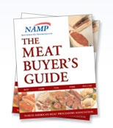
Product Specifications
Are essential for product quality and consistency
Are needed for all items purchased
Can be developed specifically for your program or can be “borrowed” from various reference resources such as:
  Meat Buyer’s Guide
  USDA grading standards
  Federal product standards
  Product suppliers such as the produce industry or canned foods packers
Multiple references for food product specifications are available on the Internet.

Slide 25

Sample Product Specification
Sample Specification
BEEF PATTY
Beef U.S. Grade Good or Better not to exceed 25 percent fat, 2.67 ounce patty, six patties per pound, no soy, meat by-pro­ducts, binders, or extenders. Meat shall be free of bone.
Meets Institutional Meat Purchase Specification #1136.

Slide 26

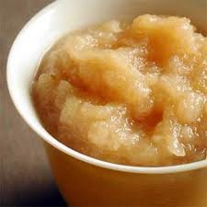
Sample Product Specification
Sample Specification
APPLESAUCE
Quality: GRADE A
Style/Variety: REGULAR OR CHUNKY
Count Size: 6 / #10
Condition: CANNED
Description: LIGHT GOLDEN IN COLOR; FREE FROM PARTICLES OR SEEDS.
LIGHTLY SWEETENED.

Slide 27
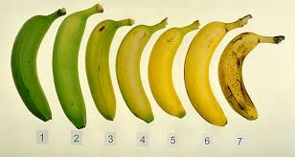



Sample Product Specification
Sample Specification
BANANAS
Quality: No. 1
Style/Variety: PETITE - 5/6" LONG
Count Size: 150
Condition: FRESH
Description: PLUMP, FIRM, BRIGHT COLORED FRUIT, FREE FROM SCARS AND BRUISES. FRUIT SHOULD BE SOLID YELLOW

Slide 28
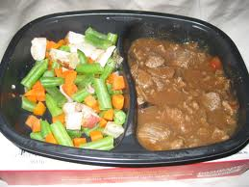
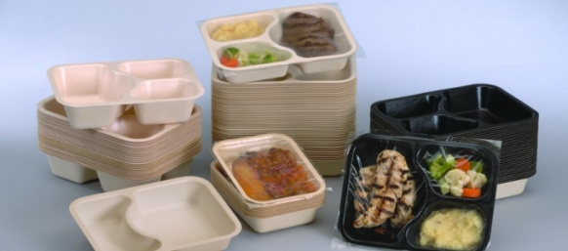
Meal Specifications
Meal Specifications must incorporate:
Federal and state menu requirements for:
  Portion sizes for meat & meat substitutes, milk, fruits and vegetables, fats, and desserts
  Food standards, i.e. meat grades, use of whole grains, fat content of milk, etc.
The “condition” of the meal, i.e. hot, refrigerated, or frozen
How the meal is to be packaged

Slide 29
Sample Specification Form
Sample form that could be used for writing product specifications:
Product Name: ___________________________
Quality: ___________________________
Style/Variety: ___________________________
Packing Medium: _________________________
Count Size: _________________________
Condition: _________________________
Description: ____________________________________________________________________________________________________

Slide 30
Contract Monitoring
The contracting process is NOT completed when the contract is signed.
Continual monitoring of the contractor’s performance is essential throughout the duration of the contract
Monitoring requires:
  Comparison of contractor performance to product or service specifications and contract clauses
  Evaluation of identified deviations
  Determination of appropriate remedial actions
  Implementation of remedial actions by the contractor

Slide 31
Contract Monitoring
Remedial actions might include actions such as:
  Contractor simply returning to performing to standards (assuming deviations are minimal)
  Compensation paid to the program by the contractor for deviations such as substitution of inferior products or other significant deviations
  Termination of the contract if deviations are major and contractor is unable or unwilling to perform to standards
Programs should NOT be afraid to terminate a contract when the contractor’s performance is unacceptable and/or not in compliance with the contract

Slide 32
summary
TO OPTIMIZE COST MANAGEMENT –
Standards are essential for all aspects of a program’s foodservice operations
Cost analyses and efforts to control costs should focus on variable costs which are controllable in the short run at the program level.
Analyses should be conducted on a regular basis. When significant variances are noted, appropriate action should be taken.

Slide 33
summary
Applying the control process to contracting for products and services:
Match products and services to your system
Contracting is a purchasing alternative which incorporates a bidding process
Clearly defined product and service specifications are essential
Cost effective contracts result from the careful preparation of detailed specifications & a careful & thorough bidding process
Ongoing contract monitoring is integral to successful cost effective contracting

Slide 34
QUESTIONS????
If you have any questions specific to your program and want to follow-up this Webinar with a discussion of your question - you are welcome to contact Dr. McCool.
Audrey C. McCool, EdD, RD, LD
Email: audrey.mccool@unlv.edu
Phone: 806-698-6956

