Slide 1
What Are The Components of a Quality Nutrition Program?
WELCOME TO THIS WEBINAR
We will begin at 3:30 PM EST
Presenters: Jean Lloyd,
Facilitators: Linda Netterville and Magda Hageman-Apol

Slide 2
Webinar Tips
To hear the presenter, you will need to phone in (toll free):
Dial: 1-866-439-4480 PIN Code: 893 007 32 # Your phone will muted upon entry so we don’t hear background noise from your office.
There will be Q&A opportunities during this webinar.
Please submit your questions/comments through the Chat Room.

Slide 3
Introduce Yourself in the Chat Room
Tell Us…
Your name, program, city and state
What is the biggest challenge for your program/organization?
What do you want to learn from the webinar?
Please type your responses in the webinar “Chat” box…
Make sure “Send to” says “All Participants”
Then click “Send”

Slide 4
What Are the Components of a Quality Nutrition Program?
Jean L. Lloyd, National Nutritionist
February 12, 2012

Slide 5
Overview
Administration on Aging
Changing environment
Proposed components of a quality nutrition program
Training & technical assistance
Resources

Slide 6
Administration on Aging
Vision In order to serve a growing senior population, AoA envisions ensuring the continuation of a vibrant aging services network at State, Territory, local and Tribal levels through funding of lower-cost, non-medical services and supports that provide the means by which many more seniors can maintain their independence.
Mission The mission of AoA is to develop a comprehensive, coordinated and cost-effective system of home and community-based services that helps elderly individuals maintain their health and independence in their homes and communities.
Reflects American Values
Supports independence.
Helps people maintain their health and well-being – better able to live with dignity in their homes, which is what Americans overwhelmingly prefer.
Helps protect the most vulnerable among us.
Avoids more costly institutional care.
Long history of non-partisan, local community & family support.

Slide 7
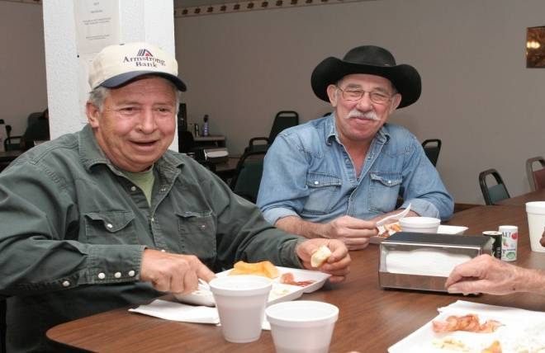
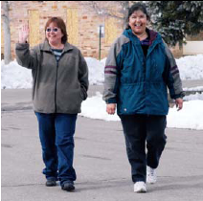
Older Americans Act Nutrition Program Purposes http://www.aoa.gov/AoARoot/AoA_Programs/OAA/index.aspx
The purposes of this part are to
Reduce hunger and food insecurity
Promote socialization of older individuals
Promote the health and well-being of older individuals and delay adverse health conditions through access to nutrition and other disease prevention and health promotion services

Slide 8
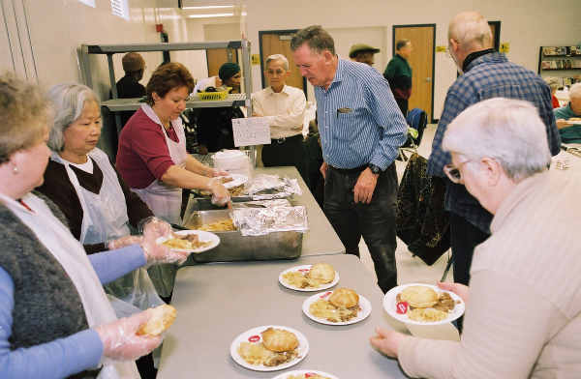
Nutrition Services Sections 331, 336, 339 http://www.aoa.gov/AoARoot/AoA_Programs/OAA/index.aspx
Services required to be provided
Meals, nutrition education, nutrition counseling
Evidence based practice
Services that may be provided
Nutrition screening & assessment, as appropriate
Services that may not be funded
Vitamin/mineral supplements
Dietary supplements

Slide 9
Broad Focus for the Older Adult
Older individual
Person, family centered
Consumer directed, consumer choice
Right services for the right person at the right time at the right cost
If funded by the OAA, services are to meet the requirements of the OAA

Slide 10
Changing Environment
Factors
Demographics
Health Status
Care Systems
Society
Business
Science
Technology
Resources

Slide 11
Demographics
More older people
More older people, living longer
More women than men
More healthy older people
Baby boomers
Diverse expectations
More frail older people
More homebound
More homebound, nursing home level of care
More potential for malnutrition
More minorities, diverse racial/ethnic composition
Diverse expectations
In states that were previously more homogeneous
More home and community based services, less facility based care
Profile of Older Americans, http://www.aoa.gov/AoARoot/Aging_Statistics/Profile/index.aspx;
Key Indicators of Well Being, http://www.aoa.gov/AoARoot/Aging_Statistics/Profile/index.aspx

Slide 12
Health Status
More young old
Healthy, active older adults, increased life expectancy, decreased functional impairment
Managing chronic conditions
More older adults who transition from hospitals, rehabilitative facilities, and nursing homes back to their own homes
More old old
More older adults who are frail and impaired
More caregiver burden
More older adults who transition from hospitals, rehabilitative facilities, and nursing homes back to their own homes
More older adults living at home who are nursing home level of care
Profile of Older Americans, http://www.aoa.gov/AoARoot/Aging_Statistics/Profile/index.aspx;
Key Indicators of Well Being, http://www.aoa.gov/AoARoot/Aging_Statistics/Profile/index.aspx
AARP Public Policy Institute, Quick Health Facts, Profile of Older Americans, http://www.aarp.org/research/ppi/

Slide 13
Care Systems
Health care
Medicare
Medical nutrition therapy
Chronic disease self management
Affordable Care Act, opportunities for the aging network increasing
Transition care
Health homes
State dual eligible demonstrations
Community First Choice Option
Public health
Chronic disease self management
Immunizations
Health & nutrition education

Slide 14
Care Systems
Home and community based care
Older Americans Act
Federal/State Medicaid waivers
Long term services and supports
Older adults & individuals with disabilities
Caregiver services
Cash & Counseling
Money Follows the Person
Managed long term services & supports accelerating
Long term care insurance
Facility based care
Assisted living
Board and care homes
Rehabilitation facilities
Nursing homes

Slide 15
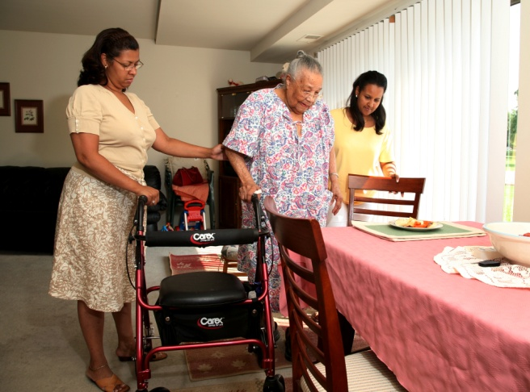
Society
Expectation that people will be able to live at home
Informal care
Family caregivers
Care by neighbors/friends, paid and unpaid
Access, service provision
Urban, suburban, rural, frontier issues
Planning for long term care needs
Aging and disability resource centers
Public/private sources of service provision
Private pay/private insurance

Slide 16
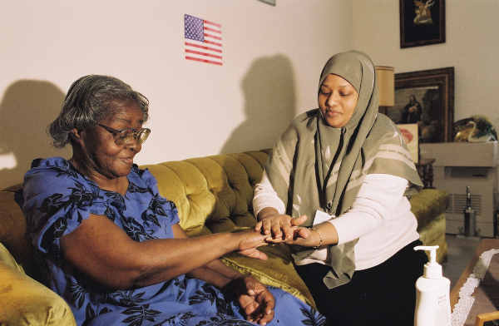
Society
Increased demand for:
Services
Quality services
Appropriate services: cultural, religious, therapeutic
Choice, kind, time, location, duration
Home and community based services
Diversity
Racial/ethnic
Functionality
Health
Age cohorts, different cohorts, different attitudes/expectations

Slide 17
Society
Baby boomers
Health oriented
Spend more, consume more health services, visit doctor more
Due to increased life expectancy, viewed as “healthy”, but have higher rates of hypertension, diabetes, obesity, and high cholesterol than previous generations*
Work centric
Continue to work past regular retirement age
Women in the work force
Independent
Change oriented
*King, et al. Status of Baby Boomer’s Health in U.S. Healthiest Generation?. JAMA Intern Med 2013

Slide 18
Science
Nutrition knowledge
Dietary Reference Intakes Food & Nutrition Board, Institute of Medicine National Academy of Sciences
Dietary Guidelines for Americans U S Departments of Health & Human Services & Agriculture
Dietary Approaches to Stop Hypertension, National Heart Lung Blood Institute of the National Institutes of Health
Total Diet Approach Academy of Nutrition & Dietetics
Health knowledge
National Institutes of Health
National Institute on Aging

Slide 19
Science
Health promotion, disease prevention, disease management
Centers for Disease Control
Health finder
Health information
Health data
Chronic condition data warehouse
Key Indicators of Well Being
Centers for Disease Control and Prevention,
Agency for Health Care Research and Quality
Trust for America’s Health

Slide 20
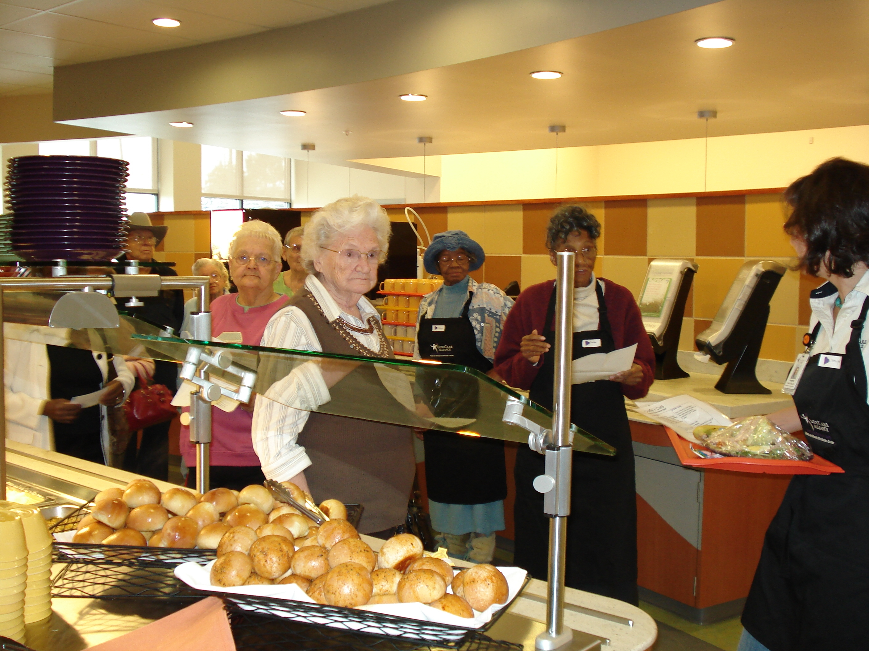
Business
For Profits
Expanding into non-traditional markets
Venture capitalists
Competing services
Restaurants, grocery stores, fitness options
Not for Profits
Becoming more entrepreneurial, social entrepreneurism
Developing community partnerships/collaborations
Identifying both public/private funding streams

Slide 21
Technology
Improved service & delivery models
Computer software, record keeping, reporting, costing, nutrient analysis
Routing/scheduling software
Websites, listservs
Improved foodservice equipment
Kitchen equipment
Packaging materials, designed for home delivered meals
Delivery equipment, designed for home delivered meals

Slide 22
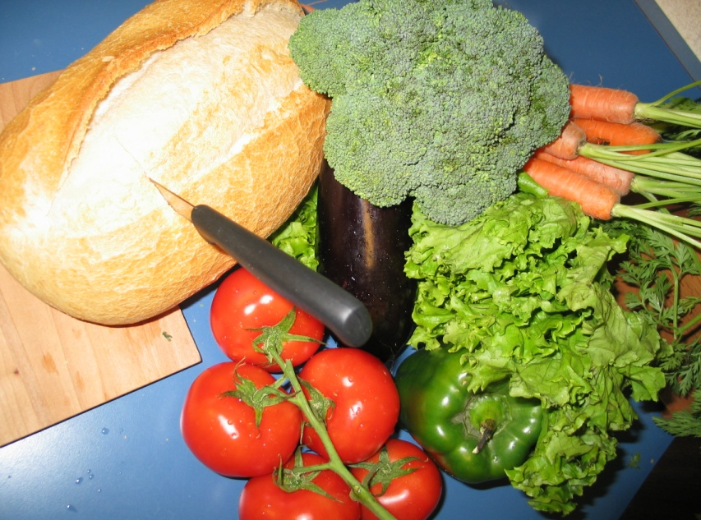
Technology
Changes in the food supply chain
Emphasis on local, fresh
Origin of food, fresh produce available year round
Changes in food products
Healthier, lower sodium, lower fat, higher fiber, more whole grains
Packaging of foods and meals
Shelf life & quality
Health focused food
Functional foods
Supplements
Probiotics

Slide 23
Technology
Food Trends
Food Trends
Demographically Directed
Still Cooking
The Appeal of Americana
Foodie Focused
Get Real
The New Nutrients
Specialty Treats
Three Squares
Prescriptive Eating
Home Rituals
Top 10 Food Trends, Institute of Food Technology, April 2011, Volume 65, No.4

Slide 24
Resources
Decreasing public funding
NASUAD & AARP Public Policy Institute: On the Verge: Transformation of Long Term Services & Supports February, 2012
NASUAD & AARP Public Policy Institute: 2012 State & Disabilities Survey, January, 2013, Decreasing state funding
Decreasing federal funding
Changes in Medicaid Waivers
Competition for limited public funding
Trend towards social entrepreneurism
Human resources, volunteerism changes, aging volunteers, but new opportunities
Need to develop efficiency, community partnerships, alternative funding, more volunteer efforts
Public/private sources demanding performance data

Slide 25
Questions
Are there any questions?
Please type your
questions in the
webinar “Chat” box.
Make sure “Send to”
says “All Participants”
Then click “Send”

Slide 26
Proposed Components of a Quality Nutrition Program
Operations
Collaboration Coordination/
Coalition
Integration
Funding
Resource
Streams
Performance
Evaluation
Business
Capacity &
Acumen
Planning

Slide 27
Planning Technical Assistance Support Center
Strategic planning: where are you going & how are you getting there
Major Activities for Strategic Planning
Strategic analysis
Strategic direction
Action planning
Models of Strategic Planning
Vision-based or goals-based
Issues-based
Alignment model
Scenario planning
Self-organizing planning
Real time planning

Slide 28
Audience Response
Does your organization have
a strategic plan?
If YES: Click the Green Check
If NO: Click the Red X
(buttons are located on the
right side of your screen)

Slide 29
Planning Technical Assistance Support Center
Business Planning
E.g., David Lavinsky* 4 questions of 10 critical questions for a business plan
1 line description of what you do
What is your financial model?
What is your action plan for success?
Why is your organization uniquely qualified?
Other critical questions
* (See: http://www.growthink.com/about-us)

Slide 30
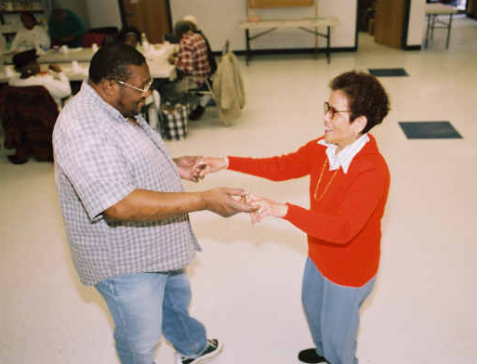
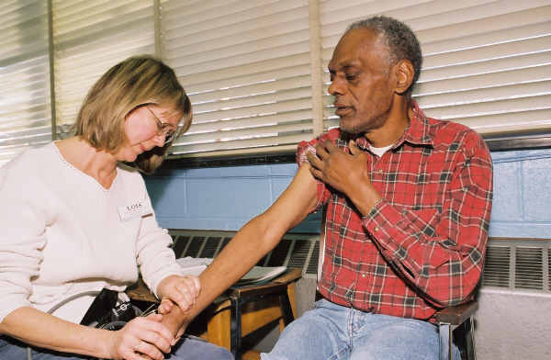
Operations
Services
Services
Meals
Nutrition education
Nutrition counseling
Nutrition screening & assessment
Activities that enhance social connectedness
Active learning
Active civic engagement opportunities
Physical activity programs
Health promotion/disease prevention programs
Chronic disease self management programs
Caregiver/family support
In home services

Slide 31
Operations
Methods of production/delivery - Meals
Small self production, non-profit
Large self production, satellite to other locations, non-profit
Contracts with for profit caterers
Contracts for other meal products such as frozen meals
Methods of development/delivery – Nutrition education/counseling, medical nutrition therapy
Steps necessary to provide to provide the product (meal, nutrition education, etc.) and services
Capacity, expertise, human resources
Use of registered dietitian in all program aspects

Slide 32
Operations Define Your Product Based on Customer Wants/Needs
Meets standards, especially for healthy eating
Choice in menu, including cultural & dietary choices
Attractive presentation of food
Knowledgeable & friendly staff
Variety of supportive programs, services and activities
Pleasant, welcoming, supportive environment
Participant input
Volunteer opportunities
Congregate-Adequate transportation & parking
Evidence based nutrition education/counseling

Slide 33
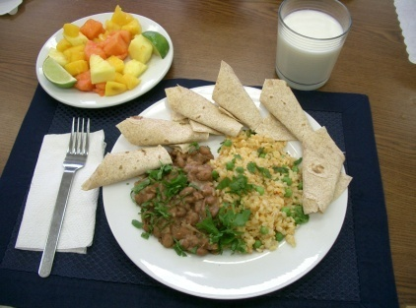
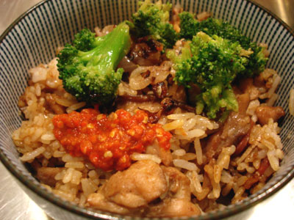
Operations Meals to meet cultural/ethnic/religious needs
Hispanic (Caribbean, Mexican, Central American, South American, etc.)
Asian (Indian, Chinese, Japanese, Korean, Hmong, Vietnamese, etc.)
Pacific Islander (Hawaiian, Samoan, etc.)
African American (regional differences)
Eastern European (Russian, Ukranian, Slovenian, etc.)
Kosher, Halal
States: AZ, CA, FL, MA, MI, MN, NJ, NY, OH, TX, WA, WI
Resource: Senior Nutrition Programs Promising Practices for Diverse Communities

Slide 34
Audience Response
Does your program offer
menus to meet cultural/
ethnic diversity?
If YES: Click the Green Check
If NO: Click the Red X
(buttons are located on the
right side of your screen)

Slide 35
Collaboration/Coordination/Coalition/Integration
Leverage
Influence, control
Collaborate
Work together, cooperate, partner
Coordinate
Organize, manage, match-up
Coalition
Alliance, merger, partnership, association
Integrate
Incorporate, combine, put together
How do we leverage, collaborate, coordinate, and integrate nutrition services as seamlessly as possible into a comprehensive and coordinated home and community based service system?

Slide 36
Collaboration/Coordination/Coalition/Integration Parallel Systems Influence Service Provision
Older Americans Act Service System
State Units on Aging, Area Agencies on Aging, Local Nutrition Service Providers
Part of a comprehensive & coordinated home and community based service system
Health Care System
Direct Health Care system, physicians, hospitals, nursing homes, rehabilitation centers ,
SNAP, SNAP-ED, TEFAP, CSFP, CACFP, SFMNP
Food stamps, food banks/pantries, soup kitchens, community gardens
Home & Community Based Service System
Medicaid Waiver Programs, Managed Care Organizations
Public Health System
State/county/city health departments
State/county funded systems & services
Chronic disease self management programs, BRFSS
Food safety & sanitation, nutrition & health education
Food Assistance System, Programs Funded by USDA
Fee for Service based on fair market value
Private Pay Systems
Insurance companies, managed care companies
Private case management
Private Industry
Restaurants, carryout, fast food, healthy fast food
Frozen /other packaged meals, grocery stores, home delivery by post
Transition care, Medical Nutrition Therapy
Notes:
OAA is not alone. We should coordinate, collaborate and leverage our programs to serve the unmet need.

Slide 37
Collaboration/Coordination/Coalition/Integration Chef Charles Club
Nutrition education collaboration
Partners: Departments of Public Health, Elder Affairs, Human Services, and area agencies on aging
Offered at sites where 50% of participants are at or below 185% of poverty
Funded by Supplemental Nutrition Assistance Program of USDA
Monthly newsletter and instructor’s guide
Fruit and vegetable intake
Low-fat milk and calcium rich foods
Physical activity
Food safety
Healthy, low-cost recipes and snack ideas
http://www.idph.state.ia.us/INN/ChefCharles.aspx

Slide 38
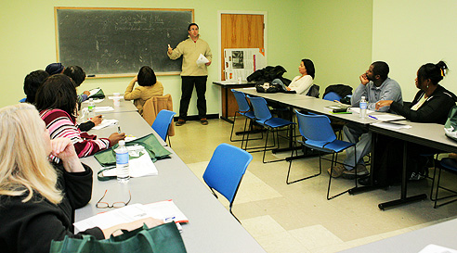
Collaboration/Coordination/Coalition/Integration Action for Boston Community Development, Inc. (ABCD)
Benefits enrollment, nutrition education, financial management collaboration
Partners: ABCD, MA Department of Elder Affairs, Brandeis University, AARP Foundation
Elder Services – Food Dollars Program
Objectives
Promote healthy eating
Reduce food insecurity, improve financial literacy & enrollment in food assistance programs
Targeting African Americans & Latino elders
Built on community partnerships
Report, January, 2013
http://www.bostonabcd.org/services.aspx

Slide 39
Business Capacity & Acumen
Culture change
Partnerships
Costing, pricing, fair market value, packaging of services
Negotiating
Scaling (cash flow, capital)
Accepting, managing risk
Marketing, communicating
Applies to public/private funding

Slide 40
Business Capacity & Acumen Culture Change Accommodating Consumer Choice
Time
Service location or place
Restaurant voucher programs
Café style service
Menu, more than 1 menu
Food item choice
More than 1 meal/day
Fee for service/private pay options
Customer service emphasis

Slide 41
Business Capacity & Acumen Tarrant County TX Meals on Wheels
In 39 years served 15,935,712 meals in Tarrant County
Offers choice of meals & services
Choice of home delivered meal, 2 meal choices
Breakfast & lunch
Case management
HomeMeds, in-home medication management program
Healthy Aging & Independent Living (HAIL) Program
One on one in-home nutrition & health counseling, targeting diabetes, in conjunction with a university and student interns
http://mealsonwheels.org/mow/default.aspx

Slide 42
Audience Response
Does your programs offer a choice of menus or food items daily?
If YES: Click the Green Check
If NO: Click the Red X
(buttons are located on the
right side of your screen)

Slide 43
Business Capacity & Acumen Create a Valued Product
Consumers Value Program Participation
 | Home Delivered | Congregate
Able to eat healthier foods | 83% | 78%
Meal enabled living at home | 92% | 60%
AoA Survey of OAA Participants, December, 2011, http://www.agidnet.org

Slide 44
Business Capacity & Acumen Components of a Business Plan
An Executive Summary
Including the objectives of the plan, the mission of the organization and, important keys to success
A Company Summary
Including your company history and ownership information
A Service(s) Description
Including a competitive comparison and your proposed sales literature

Slide 45
Business Capacity & Acumen Developing a Business Plan - Communication
A good business plan:
Sets a course, builds a bridge
Shows how you are going to get from here to there
Answers your stakeholders & critics questions
Educates
Your Community
Your Staff
Your Clients and Stakeholders
Your Funders
Answers the tough questions
Shows data to support the success of the plan
Littke, R.. Making a Profit in a Non-Profit World, 2008., Senior Services, Kalamazoo, MI

Slide 46
Business Capacity & Acumen Determine Your Market - Communication
Who are your participants/clients/consumers
Only those targeted by the OAA OR
All older adults in the community regardless of income who need your services
What is your “niche”
What do you do that is different, unique, desirable?
Who are your stakeholders?
Littke, R.. Making a Profit in a Non-Profit World, 2008., Senior Services, Kalamazoo, MI
Notes:
Your Clients – Should be viewed as those in need, not those in need with NO MONEY.
Your “Niche” – You need to determine Who needs your services, What you will offer them that is different, unique and desirable from other providers.
Your Stakeholders – Think outside of the box. There are MANY stakeholders who would benefit from the service you provide. The client has family, friends and others who can be asked to provide financial assistance. Many family members will participate in paying for services for their loved ones, but no-one asks!

Slide 47
Audience Response
Who does your program currently target for service? (Check all that apply)
Populations under 60
All populations over 60
Over 60 + High nutritional risk
OAA targeted populations (minority, low income, rural)
Others (If “others,” please describe in the Chatroom)
Please choose your responses in the “Poll” Panel, then click the “Submit” button.

Slide 48
Funding/Resource Streams
Public
Private

Slide 49
Funding/Resource Streams OAA Nutrition Program Leveraged Funding
Home Delivered Meals
Congregate Meals
69%
Leveraged Funds
From state, city, county, contributions, fund-raising, food donations, grants, etc.
State Program Reports http://www.aoa.gov/AoARoot/Program_Results/SPR/Index.aspx

Slide 50
Funding/Resource Streams OAA Nutrition Program Contributions/Meal
State Program Reports http://www.aoa.gov/AoARoot/Program_Results/SPR/Index.aspx
Notes:
Since 2007, the contribution per meal has consistently decreased for congregate
and home delivered meals.
Contributions for congregate have decreased $0.14/meal and for home delivered
$0.17/meal.

Slide 51
Funding Resource Streams OAA Nutrition Program Expenditure Trends
Year | Expenditure/Meal |  | Expenditure/Participant
 | Congregate $ | HD $ | Congregate $ | HD $
2010 | 6.64 | 5.34 | 376.00 | 895.00
2009 | 6.75 | 5.30 | 383.00 | 902.00
2008 | 6.96 | 5.14 | 379.00 | 830.00
2007 | 6.61 | 5.13 | 369.00 | 791.00
Since 2007, in general, congregate and home delivered meal expenditures have increased, but not consistent year to year.
Since 2007, total expenditure per participant has increased.
State Program Reports, http://www.aoa.gov/AoARoot/Program_Results/SPR/Index.aspx

Slide 52
Funding/Resource Streams Revenue Sources
Public/Government
Private
Older Americans Act
Title III (C1, C2, NSIP), V, VI
Potential decreases
Congressional appropriations
Older Americans Act match
Other federal
Social services or community service block grants
State
Funding, programs vary by state
County/City
Medicaid Waiver
From fee for service to managed care
Grants
Participant contributions
Fund raising
Third party payments & insurance
Private pay
Payment for other services such as catering
Payment for other programs, USDA child nutrition programs
Grants from organizations such as United Way, or private foundations

Slide 53
Funding/Resource Streams Public Pay & Private Pay
All clients are offered services on a “Donation Only” basis
All clients have full pay option explained
Other stakeholders can be involved
All clients are informed about limited (donation only) services
Other stakeholders often want to help pay for additional services
Littke, R.. Making a Profit in a Non-Profit World, 2008., Senior Services, Kalamazoo, MI

Slide 54
Audience Response
Which of the following funding streams does your program currently access? (Check all that apply)
OAA
Medicaid Waiver fee for service
Medicaid Waiver managed care
State only funding
City/county only funding
Health insurance
Private or self pay
None of the above
Please choose your responses in the “Poll” Panel, then click the “Submit” button.

Slide 55
Funding/Resource Streams Sources of Organizational Abundance – James Firman, NCOA
Self Pay
Increase client incomes to pay for services
Health insurance & 3rd party pay
Donations-Ask & you will receive
Investing wisely in volunteers
In-kind support
Funding & Sustainability, NCOA http://www.ncoa.org/get-involved/funding-sustainability/

Slide 56
Funding/Resource Streams Sources of Organizational Abundance – James Firman, NCOA
Strategic partnerships with business
Strategic alliances with other non-profits & government agencies
Social entrepreneurship-creating a new business venture
Community building & fundraising on the internet
Foundations& government
Advocacy
Funding & Sustainability, NCOA http://www.ncoa.org/get-involved/funding-sustainability/

Slide 57
Funding/Resource Streams Social Entrepreneurism
Three Cs
Core competencies
Capability
Constituencies
Examine your assets
Tangible, intangible
Identify your weaknesses
Partner with organizations that correspond to your weaknesses
Funding & Sustainability, NCOA http://www.ncoa.org/get-involved/funding-sustainability/

Slide 58
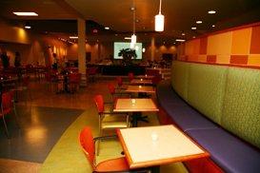
Funding/Resource Streams Lifecare Alliance-Columbus OH
Social Entrepreneur – Private Non-Profit
Programs
Nutrition: Meals on Wheels, Senior Dining Centers, Groceries to Go, Senior Farmers Market, Project Open Hand
Health & Wellness: Columbus Cancer Clinic, Wellness Centers
In Home Services: Help at Home, Visiting Nurse Association
IMPACT Safety, fee for service safety program for men, women, teens
Catch the Corporate Wellness Spirit, adult immunizations & travel vaccines, worksite wellness, 37 business sites
Foodservice entrepreneurism
Carrie’s Café – restaurant & wellness center, open to the public as well as Title III nutrition participants
Meals for Kids Program- afterschool care program meals for children
LA Catering-for profit catering company
Wedding menu, bar menu, lunch & learn menu, seasonal specials, preferred caterer for 15 venues
http://www.lifecarealliance.org/

Slide 59
Performance and Evaluation
Performance
Evaluation

Slide 60
Performance
Definition
Form of Program Assessment
Ongoing monitoring & reporting of accomplishments
Progress toward an established goal
May be conducted by experts internal to the program
Measures may address
Type/level of program activity
Direct products/services delivered (outputs)
Results of products/services (outcomes)
Definition of “program”
Any activity, project, function, policy with an identifiable purpose or set of objectives
Performance Measurement & Evaluation: Definitions & Relationships. GAO-05-739SP.May, 2005 http://www.gao.gov/

Slide 61
Evaluation
Definition
Form of Program Assessment
Individual systematic studies conducted periodically to assess how well a program is working
Typically conducted by experts external to the program
Examines achievement of program objectives in context of other aspects of program performance
Purpose: learn benefits/how to improve program
4 types
Process (Implementation) Evaluation
Outcome Evaluation
Impact Evaluation
Cost-Benefit or Cost-Effectiveness Analysis
Performance Measurement & Evaluation: Definitions & Relationships. GAO-05-739SP.May, 2005 http://www.gao.gov/

Slide 62
Performance and Evaluation Different Focus & Different Use
Performance Measurement
Has the program achieved its objectives as expressed by measurable standards
Answers the questions: what, how
Program Evaluation
Broader range of information & context
Examines aspects of program operations or factors in program environment that contribute/impede success
Estimates what might occur without the program
Compares effectiveness of alternative programs with the same objective
Provides an in-depth examination of the program performance & context to improve results
Answers the question why
Performance Measurement & Evaluation: Definitions & Relationships. GAO-05-739SP.May, 2005
http://www.gao.gov/

Slide 63
Performance
Outputs
Standards
Quality
Monitoring
Outcomes

Slide 64
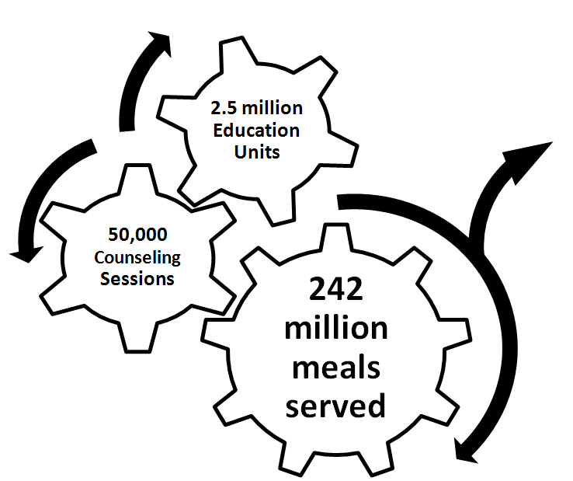
Performance: Outputs
2.5 million Education Units
60% Home Delivered
50,000 Counseling Sessions
242 million
meals
served
Congregate:
1,733,176 older adults
Home Delivered:
868,076 older adults
2010 AoA State Program http://www.agidnet.org/

Slide 65
Performance Standards OAA Sections 339, 601
2010 Dietary Guidelines for Americans
Dietary Reference Intakes
Food Safety Code

Slide 66
Performance: Quality Participant assessment of meal & services
Question | Congregate% | Home-delivered %
Rating of meal good to excellent | 92 | 88
Satisfied with food taste Always/usually | 80 | 75
Satisfied with variety of food Always/usually | 82 | 77
Rate the program overall Excellent/very good | 71 | 65
Recommend to a friend | 95 | 96
National Survey of OAA Programs, 2011, Administration on Aging http://www.agidnet.org/

Slide 67
Performance: Quality Participant Assessment of Meal Changes in Past 12 Months
Characteristic | % Congregate | % Home Delivered
Noticed change | 25 | 23
Food quantity decrease | 27 | 29
Food quality decrease | 22 | 23
Meal service less often | 1 | 1
Fewer meals served | 1 | 0
Fewer food choices | 12 | 10
More cold/frozen meals | 3 | 2
National Survey of OAA Programs, 2011, Administration on Aging http://www.agidnet.org/

Slide 68
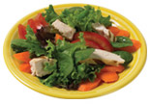
Performance: Monitoring Principles of Menu Planning
Aesthetic appeal:
Enhance taste
Strive for balance
Emphasize variety
Add contrast: texture & temperature
Think about color
Consider eye appeal

Slide 69
Performance: Monitoring Preferences
Culture, ethnicity, traditions
Religion, holidays, celebrations
Family
Region of the country
Health
Age, generational cohort
Gender

Slide 70
Performance: Monitoring Standards, Appeal Monitoring
Aesthetic Appeal
Nutrient Content
Taste
Balance
Variety
Contrast: temperature, texture
Color
Eye appeal
Fruits & vegetables
Lean protein
Whole grains
Low-fat dairy
Lower fat preparation
Lower sodium foods
Lower added sugars

Slide 71
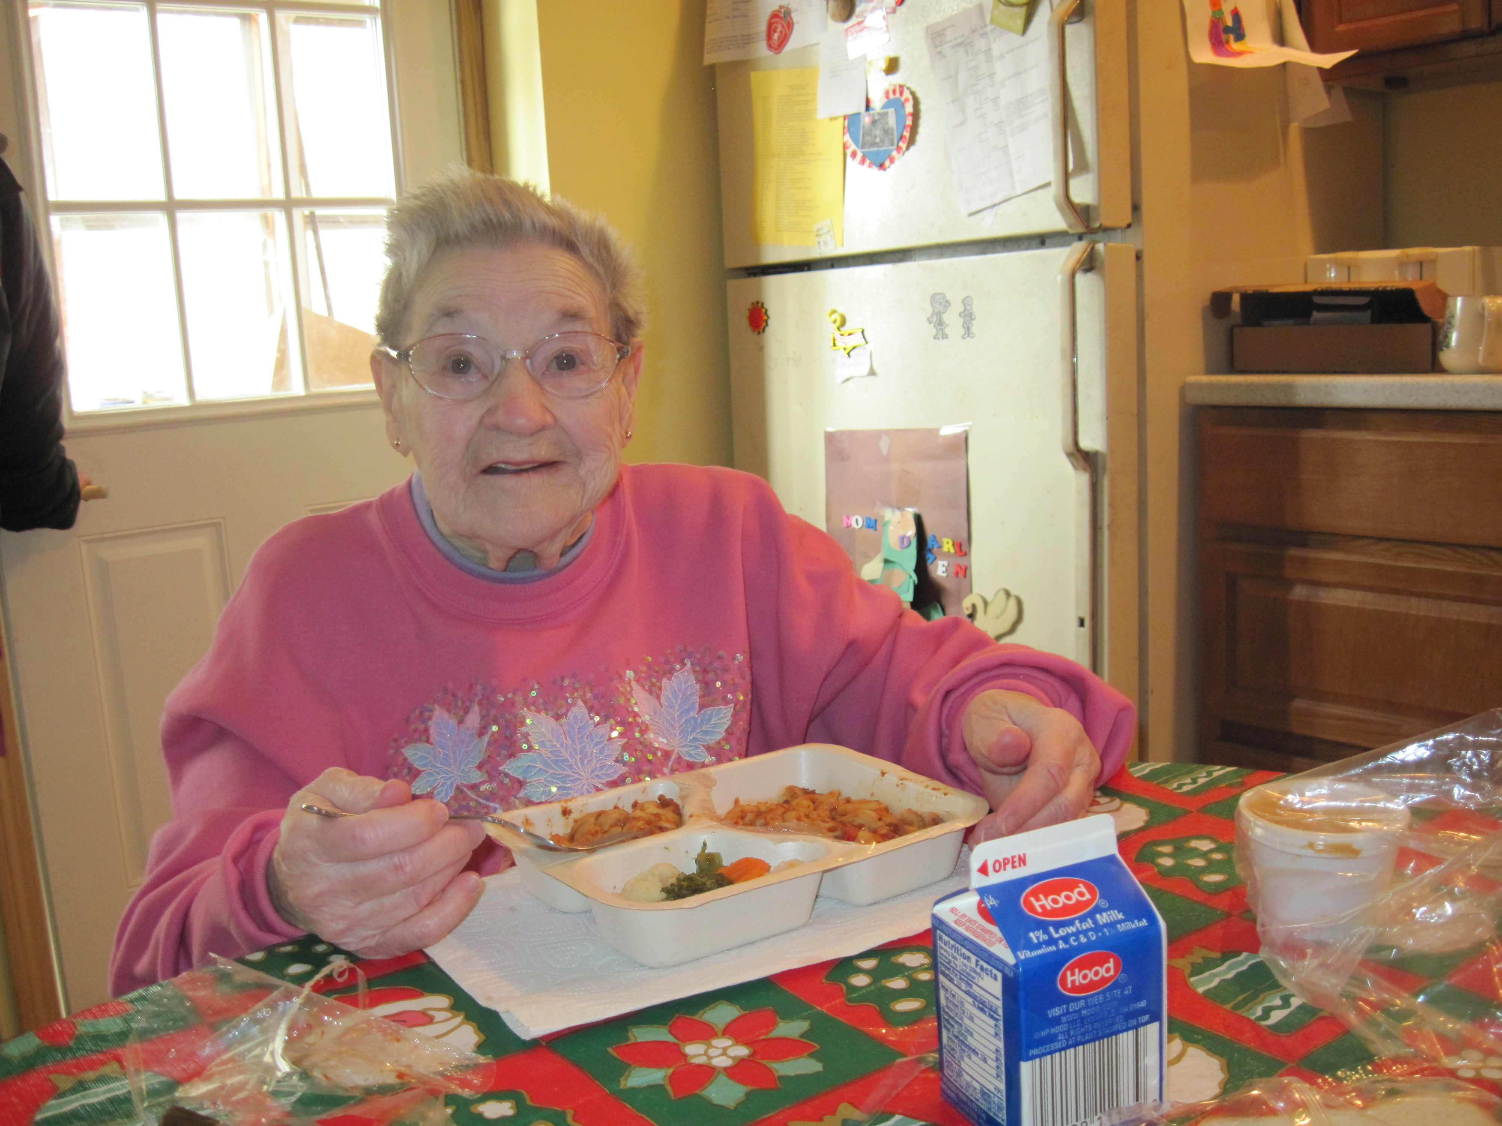
Performance: Outcomes Targeting for Nutrition Services
Greatest social need
Greatest economic need
Low income
Low income minorities
Rural
Limited English proficiency
Risk of institutionalization
OAA Sections 102, 305, 306, 331, 336, 339, CFR 1321.69 http://www.aoa.gov/AoARoot/AoA_Programs/OAA/index.aspx

Slide 72
Performance: Outcomes Targeting
Percentages compared to U.S. Population

Slide 73
Performance: Outcomes Targeting – Functionally Impaired Seniors
Congregate:
72%

Slide 74
Performance: Outcomes Targeting – Functionally Impaired Seniors
Home Delivered:

Slide 75
Performance: Outcomes Targeting – Those in Poor Health
Congregate:

Slide 76
Performance: Outcomes Targeting – Those in Poor Health
Home Delivered:

Slide 77
Performance Outcomes: Targeting – At Risk Participants
Characteristic | % Congregate Meals Participants | % Home Delivered Meals Participants
Poverty | 26 | 39
Receive Food Stamps | 7 | 15
Single meal provides ½ or more of total food for the day | 51 | 61
Don’t have enough $ or food stamps to buy food | 11 | 8
Take 5+ Medications | 31 | 61
Choose between food & medications | 9 | 18
Choose between food, rent & utilities | 6 | 12
AoA Survey of OAA Participants, December, 2011, http://www.agidnet.org/

Slide 78
Performance Outcomes: Perceived Benefits
Characteristic | % Congregate Participants | % Home Delivered Participants
Meal enabled living at home | 60 | 92
Eat healthier foods as a result of the program | 78 | 83
Eating meals improves health | 78 | 87
Meals help feel better | 85 | 90
See friends more often | 83 | NA
Recommend to a friend | 96 | 96
National Survey of OAA Participants, December, 2011, http://www.agidnet.org/

Slide 79
Performance Outcomes: Using Data for Advocacy— Michigan Approach
Profile of MI HDM clients
Profile of funding pressures
Participant assessment of services
State funding contribution 17%
State value
Leveraging funding sources
MI employment, programs averaged 27 FTE
Compared HDM expenses to other more expensive services to demonstrate value such as personal assistance, home care, home maker, chore
Volunteer hours contributed
Amount of food purchased from MI companies, specific targets to increase food purchased from MI companies
State advocacy message: The aging network provides in-home support services and meals for $4.72/person/day, the price of a premium cup of coffee. The MI HDM supports MI employment and agriculture.
Overview: The Value and Outcomes of Michigan’s Home Delivered Meals
for the Elderly Program Report, Area Agency on Aging1-B Southfield, MI Senior Nutrition. Karen Jackson

Slide 80
Audience Response
What kind of outcome measures does your program use? (Check all that apply)
Participant characteristics
Participant assessment of services
Documentation of health care utilization
Documentation of efficiency
Other
(Please describe in the chat)
Not Applicable
Please choose your responses in the “Poll” Panel, then click the “Submit” button.

Slide 81
Performance Evaluation Savings of Nursing Home Costs
Home delivered meals reduces nursing home use.
States that invest in community based service networks, particularly home delivered meals have proportionally fewer low-care nursing home residents.
Increased investment in OAA services affects the general population and sustains them longer in the community.
Follow up analysis lists states which invest the most and least LTCFocus.org
Thomas, K & Mor, V. The Relationship between Older Americans Act Title III State Expenditures & Prevalence of Low-Care Nursing Home Residents. Health Services Research .12.3.12 http://onlinelibrary.wiley.com/doi/10.1111/1475-6773.12015/abstract

Slide 82
Training & Technical Assistance http://nutritionandaging.org
“Momentum: Advancing into Future Readiness”
Online library
Nutrition, Food & Health
Professional Development
Resources & Tools
Public Policy
Provider Operations & Tools
Topic guides
Proceedings of Perspectives of Nutrition and Aging: A National Summit http://nutritionandaging.org/summit
Perspectives Challenge, Best & Promising Practices

Slide 83
Next Webinar
What Are the Components of a Quality Nutrition Program – Part 2
February 26 from 3:30 to 4:45 PM EST
Register for the next in the webinar series: http://nutritionandaging.org/momentum

Slide 84
Resources
To access the sources cited in this presentation, as well as additional supporting resources, please see the Topic Guide in the Online Library
http://nutritionandaging.org/ guide-quality-program

Slide 85
Summary
We face a time of increasing diversity in the people we serve, changing environments, and changing services.
Together, we can modernize service provision through quality service provision.
For more information about ACL
U.S. Department of Health and Human Services, Administration on Community Living, Washington DC 20201, www.aoa.gov

Slide 86
Jean L. Lloyd, National Nutritionist, U S Administration on Aging
jean.lloyd@aoa.hhs.gov

