Slide 1

Surviving a Changing Environment
Pam VanKampen, RD, CD
pam.vankampen@gwaar.org
715-836-3916

Slide 2
http://www.youtube.com/watch?v=bKLQBuSPVwQ

Slide 3

What Do You See?
“If you focus on the problem you can’t see the solution.”
“Look beyond the fingers- never focus on the problem.”
“See what no one else sees.”
“See the whole world anew each day!”
        Patch Adams opening Scene quotes

Slide 4
Always Remember Why We Do What We Do!
Don’t lose sight of the purpose of the program
  To reduce hunger & food insecurity
  To promote socialization of older adults
  To promote the health and well-being of older individuals by assisting such individuals gain access to nutrition and other disease prevention and health promotion services to delay the onset of adverse health conditions resulting from poor nutritional health or sedentary behavior.

Slide 5
Objectives of the Program
Prevent malnutrition and promote good health behaviors through:
  nutrition education
  nutrition screening
  intervention of participants
Serve wholesome, delicious meals that are safe and of good quality, through the promotion and maintenance of high-food safety and sanitation standards.

Slide 6
Objectives of the Program(cont.)
Promote or maintain coordination with nutrition related and other supportive services for older individuals.
Target older adults who have the greatest economic & social need with particular attention to low-income minority & rural individuals.

Slide 7
“Goal: delay in-home services - giving people a purpose to get up, get dressed and leave the house is very important especially as we age.”
Jean Lloyd, AoA National Dietitian
  “CREATE A PURPOSEFUL ROLE for them. They need a reason to get up and to have meaning and give back.”
  (Dr. Robert Butler at NCOA/ASA Conf. Chicago March 2010)

Slide 8
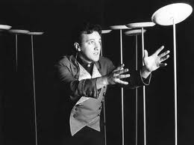
Are You Spinning Plates?
Do you have the want and desire to make changes, but you have so many plates in the air you can only concentrate on the immediate future and keeping them spinning?

Slide 9
What Do Consumers Want?
Don’t make assumptions
Don’t operate in a silo
Have to ask, engage, excite and unite them!
  “Spark Sheets”
  One-on-One Interviews
  Niatx Process Improvement Process (Walk Through)
  Asset Based Community Development (ABCD)
  Focus Groups
  Surveys

Slide 10
What Do Consumers Want? (cont.)
LISTEN & pay attention to where seniors are and what they are saying.
Look at large organizations and learn from them; what are they focusing on? (Local Foods, Marriott Service Promises).
Adapt Restaurant Trends (i.e. Menu Labeling, Senior Specials).

Slide 11
“Spark Sheet”
"Today's problems cannot be solved if we still think the way we thought when we created them."
Albert Einstein
When a group of people come together and brainstorm, one idea or “spark” leads to another and soon the energy in the room ignites and “fire” is created.
The “Spark Sheets” allow many different ideas to be shared. The ideas come from various grass root brain storming sessions. The sheet should be a fluid document with new ideas added or adapted as they develop.

Slide 12
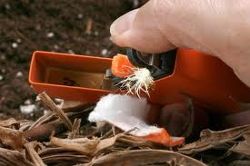

What are the nutrition issues that concern older gentlemen and what can we do to address these concerns?

Slide 13

“Walk Through”
Overview:
Process improvement system is customer driven. Remember we are looking at the processes in place and how the process influences customers.
Important to suspend judgment and just observe the process - ask yourself how does this make you feel or how would my parents feel going thru this system?
Identifying opportunities for improvement; flow chart to see the big picture then pick the "low hanging fruit" to address first.
Notes:
Process improvement system is customer driven. Remember we are looking at the processes in place and how the process influences customers- process improvement not staff/volunteer/person improvement.
It is extremely important to suspend judgment and just observe the process- ask yourself how does this make you feel or how would my parents feel going thru this system? Don't go to the next level of making value judgments.
We will be identifying several opportunities for improvement and we will flow chart these out so we can see the big picture and pick the "low hanging fruit" to address first.
We will be doing small process changes that can be done quickly and demonstrated that the change makes a difference in the process, tools such as the Fishbone Diagram, nominal group technique and brainstorming will be used. This will lead to the bigger system change eventually,.
The beauty of this process is that it brakes down the often overwhelming task of system change into doable steps and allows small successes to be celebrated along the way; this helps maintain excitement and energy in the process vs. feeling overwhelmed.
We want to empower people so they have successes and we want to be seen as a partner in creating change.

Slide 14
“Walk Through” (cont.)
Overview:
Do small process changes that can be done quickly (Plan, Do, Study, Act or PSDA cycles) and demonstrate that the change makes a difference in the process. This will lead to the bigger system change eventually.
The beauty of this process is that it brakes down the often overwhelming task of system change into doable steps and allows small successes to be celebrated along the way; this helps maintain excitement and energy in the process vs. feeling overwhelmed.
We want to empower people so they have successes and we want to be seen as a partner in creating change.
Notes:
Process improvement system is customer driven. Remember we are looking at the processes in place and how the process influences customers- process improvement not staff/volunteer/person improvement.
It is extremely important to suspend judgment and just observe the process- ask yourself how does this make you feel or how would my parents feel going thru this system? Don't go to the next level of making value judgments.
We will be identifying several opportunities for improvement and we will flow chart these out so we can see the big picture and pick the "low hanging fruit" to address first.
We will be doing small process changes that can be done quickly and demonstrated that the change makes a difference in the process, tools such as the Fishbone Diagram, nominal group technique and brainstorming will be used. This will lead to the bigger system change eventually,.
The beauty of this process is that it brakes down the often overwhelming task of system change into doable steps and allows small successes to be celebrated along the way; this helps maintain excitement and energy in the process vs. feeling overwhelmed.
We want to empower people so they have successes and we want to be seen as a partner in creating change.

Slide 15
Example: First Meal
Observations
Was it easy to find the meal site?
Were parking, directions, and signage adequate?
Were you welcomed to the meal site in an open and friendly manner?
Did the site feel pleasant and welcoming or cold (negative) and harsh?

Slide 16
Example: First Meal (cont.)
Observations
Were the people/participants pleasant and welcoming or cold (negative) and harsh?
What did you do while waiting for the meal to be served?
Was the meal served on time?
Was the meal site clean and neat and were the staff/volunteers also clean and neat?
Please rate the meal using the table below (5 being the best)

Slide 17
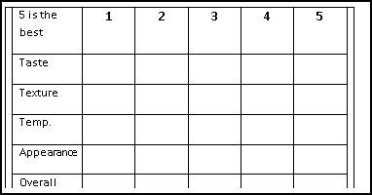
Rating Scale

Slide 18
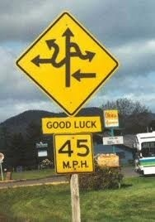
You Need A Plan…otherwise Chaos!
Many innovative things are happening but coordination and sharing of this information can be a challenge.
Working document to work collaboratively to modernize the nutrition program.
Operating under the same overall strategic plan we can work together to best serve the seniors, while still allowing for individual choice for modernization by each local county or tribe.
All lessons learned will be shared with the State Elderly Nutrition Task Force so policy change can be made if necessary.
Notes:
Many innovative things are happening throughout WI but coordination and sharing of this information can be a challenge.
Working document to work collaboratively to modernize the nutrition program. As these connections are made, true progress can be realized.
Operating under the same overall strategic plan, the entire state will benefit from working together to best serve the seniors of WI, while still allowing for individual choice for modernization by each local county or tribe. All lessons learned will be shared with the State Elderly Nutrition Task Force so policy change can be made if necessary.

Slide 19
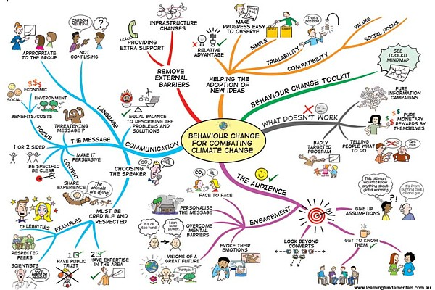

Slide 20
“Best Practice” Categories
Culture of Inclusion
Seniors Really in Charge
Welcoming Environment Consistent Quality Services
Individual Relationships Statewide Expertise in Aging Services and Systems & A Focus on Community Collaboration
Choice & Customization Convenient Service Areas
Improve the Meal Experience Core Service Provided Statewide and Consistent Quality Services
Go Beyond Just the Meal Individual & Organizational Advocacy
Seek Feedback and Respond Consistent Quality Services
Chance to give, not just get Volunteers are Key to Service Delivery
Marketing and Outreach
Source: Greg Newton, Greg Newton and Associates from presentation Serve More Meals: Welcome First Time Visitors and Keep Them Coming Back Again and Again at the PA Nutr. Dir. Conf. 2010.

Slide 21

Culture of Inclusion!

Slide 22
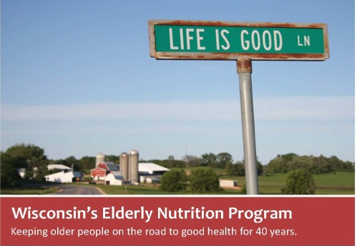
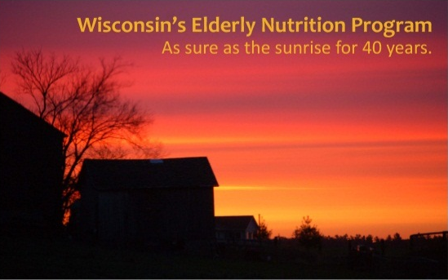
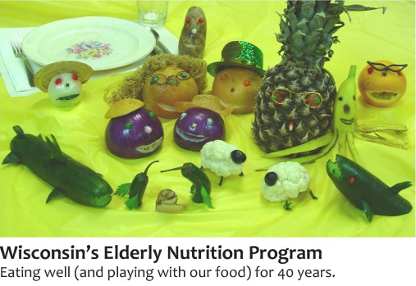
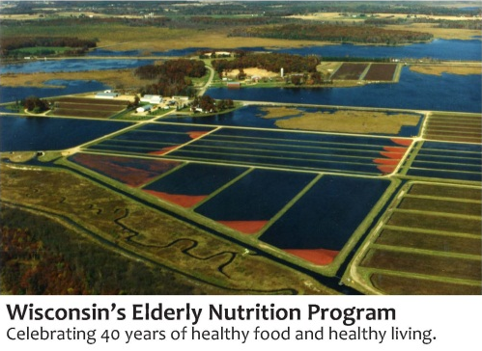




Please vote for the poster you think best captures the spirit of the Wisconsin Elderly Nutrition Program and that will spark discussion. Vote for your top 3 choices by placing an X in the box to the left of the picture. Voting ends on August 17, 2012, at midnight. Please only vote once. Thank you! Your vote matters.

Slide 23
Culture of Inclusion
Get participants buy-in to form new initiatives (Examples)
  Recipe contest submitted by the seniors (Pepin)
  Form a Committee of Seniors to take ownership of various programs (i.e. activities) (Florence)
  Cooking Classes with seniors teaching…
    Cooking for Men,
    Cooking with Diabetes, Celiac, etc…
    Cooking for 1 or 2

Slide 24

Heard it Through the Grapevine…
Seniors Really in Charge!
Seniors Strengthen Communities!
Add Value!
Powerful!

Slide 25
Promises…
Always…offer a dining site that is safe, comfortable,
and clean; that has a cheerful, friendly atmosphere that promotes socialization and
offers health promotion activities.
Always…provide safe, high-quality, well-balanced meals.
Always…make you feel at home and welcome.
Always…deliver service that will make you want to keep coming back.
Draft…to build grass roots support the nutrition staff will be involved in developing these this fall.

Slide 26
One-on-One Interviewing
A conscious exploration of another person’s interests, passions, relationships and stories.
Listen for what energizes and activates the person.
Way to build “public knowledge”
  Listen for people’s public interests and potential to take action with others.
Sample Question:
“What are the 3 most important issues facing older adults in your community?”

Slide 27
One-on-One Interviewing
Advantages
Disadvantages
People tend to share a lot more information when someone is asking the questions in person.
It’s much easier to ask a follow-up question and get examples to support what people are saying.
It gives people an opportunity to participate in a more direct way, and they have a greater buy-in to the results of the assessment process.
They’re time intensive, and trying to schedule the interview can be a full-time job in itself.
Sometimes people use them as an opportunity to vent about everything that’s wrong with an organization, putting you on the defensive and leaving you to sift through their remarks for constructive criticisms.
http://www.thenonprofittimes.com/article/detail/advantages-and-disadvantages-to-1-on-1-interviews-4535

Slide 28
Tips and Tools of One-on-One Interviewing
Be prepared
Keep it informal
Look for connections
Ask direct questions
Avoid yes/no questions
Listen well
Be sure you understand
Look for the energy for action
Evaluate

Slide 29
NCOA/ASA Annual Conference that was held in Chicago in March of 2010
The average retiree watches 48 hours of television a week!
We need more roles for older adults, they have more discretionary time and want to be involved with things that give them purpose and are meaningful. They want to do something that makes use of their talents vs. basic skills, i.e. develop a marketing plan or ways for your organization to be more effective communicators, etc… vs. mindless tasks such as stuffing envelopes.

Slide 30
NCOA/ASA Annual Conference that was held in Chicago in March of 2010
We need to have expectations for them - they want to give back. People want to stay connected. They want to engage and connect with the world.
Social Security created a mindset that once you turn 65 you are on vacation. We need to invite older adults back in. We need a wall of programs for seniors to give back, show us, lead us, etc…

Slide 31

Teach Seniors to Fish…
Activity Booklet
“MeYou Health” Daily Wellness Challenge
Theme Days
“Purpose Planning”
SNAC Program
Evidence Based Programming
Nutrition Coalitions
“More than a MEAL Café”

Slide 32
Cranberries Newspaper Column
Cranberries Presentation
Cranberry Crossword
Cranberry Maze
Cranberry MOW Flyer
Cranberry Recipe Cards – 1
Cranberry Recipe Cards – 2
Cranberry Recipe Cards – 3
Cranberry Table Tent
Ocean Spray Cranberry 101

Slide 33
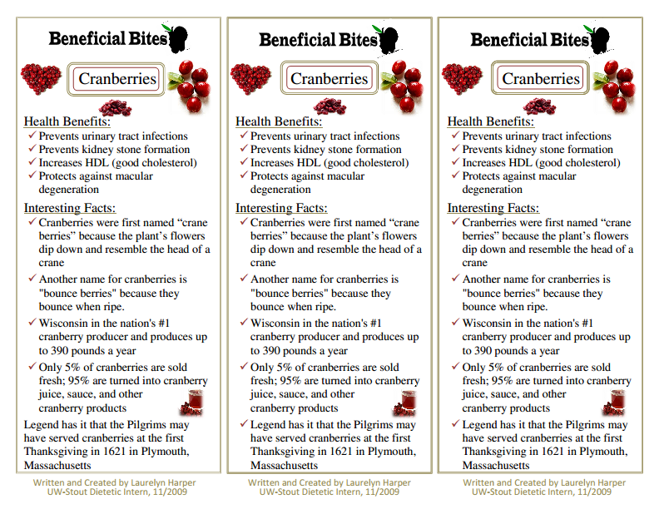

Slide 34
Wisconsin Cranberry Marsh
WI Elderly Nutrition Program Poster Contest Finalist

Slide 35
Standardization with Customization
Offer options and choices for each community to choose what energizes them.
You can have uniformity but still allow communities the freedom to make it their own.
  “More Than a MEAL” examples

Slide 36

We Are So Much More than A MEAL!

Slide 37
We are not a restaurant. We offer one wholesome meal a day but we offer so much more designed specifically for people age 60 plus. Think of this as YOUR place to hang out, have fun, laugh, enjoy and grow friendship and socialize. We want you to help us shape what will be offered at this location such as educational, health and wellness activities and programs that help you maintain your independence. It can be a hub for you to volunteer, give back to and strengthen your local community in various ways; YOU can make a difference.
Please join hostess _______ for food, socialization & fun! Our friendly bus driver will be glad to pick you up!
We look forward to Seeing You Soon

Slide 38
Advocacy
Mobilize
Empower
All Together or All for One
Leverage

Slide 39
Home Delivered Meals
Meal
Encouragement
Assurance
Love

Slide 40
Dining Experience
Meeting place
Entertainment/Education/”Edutainment”
Activities
Laughter

Slide 41
Volunteer Hub
Make A Day!
Enhance Lives!
Add Hope!
Lighten Loads!

Slide 42
“Purpose” Place
Make a Difference
Excite/Energize/Empower
A role to play
Leave a legacy

Slide 43
Partnerships/Relationship Building/Networking
Make connections
Educational opportunities or
Enhance the Community
Advocacy/Action
Learn from Each Other

Slide 44
Assume Your Role Leaders!
  Leaders grow relationships and partnerships.
  Should be having 2-3 conversations per week with potential partners to build informal relationships.
  Informal authority is earned…thru relationship building, you need to be connected in the community; keep people close and related.
  Leaders are people who create a shared vision powerful enough to lift people out of their
  day-to-day petty preoccupations and focus
  them on things worthy of their effort.

Slide 45
“Whole Person Wellness” Wisconsin Elderly Nutrition Program Tagline
“Feeding the Whole Person”

Slide 46
Wisconsin's Elderly Nutrition Program Provides SUSTENANCE:
Socialization
Utilized by people 60+
Screening
Targets those most in need
Education
Nourishment
Assessment
New Serving Options
Community Service
Enhances Independence

Slide 47
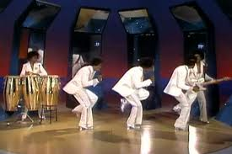
Remember to Enjoy Yourself…
“Wow” Experience
Fun
Energy
Purpose
Engagement
Friendship/Socialization
Passion
Enthusiasm

Slide 48
In Summary
What do you see for the future of your program?
Have the courage to see what others choose not to.
Thank you for Allowing me to Highlight what we are doing in Wisconsin. Please contact me if you have any questions/comments.
Sincerely, Pam

