Slide 1
The Community-based Care
Transitions Program
Juliana R. Tiongson, MPH
The Innovation Center
Centers for Medicare and Medicaid Services

Slide 2
The Community–based Care Transitions Program (CCTP)
The CCTP, created by section 3026 of the Affordable Care Act, provides $500M over 5 years to test models for improving care transitions for high risk Medicare beneficiaries.
We currently have 47 communities projected to serve approximately 220,000 high risk Medicare beneficiaries across 21 states annually
Our final review of applications for CY 2012 is scheduled for September 20, 2012
2

Slide 3
Program Goals
Improve transitions of beneficiaries from the inpatient hospital setting to home or other care settings
Improve quality of care
Reduce readmissions for high risk beneficiaries
Document measurable savings to the Medicare program and expand program beyond the initial 5 years
3

Slide 4
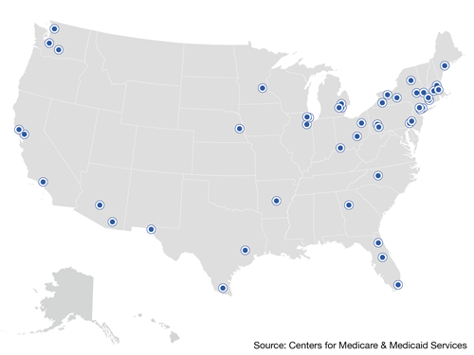
The CCTP Partners

Slide 5
Who are these CCTP Participants?
Two types of primary applicants : 43 are CBOs, and 4 are high-readmissions hospitals, partnering with CBOs
1) Forty-three CBO lead applicants:
Includes AAAs, ADRCs, non-profit home and community-based service providers, physician hospital organizations, visiting nurse services, community health centers, and other Medicare providers
2) Four high-readmission hospital lead applicants:
St. John Providence Health System in Warren, MI, partnering with Adult Well-Being Services, a service provider of the Detroit AAA, and
Yale-New Haven Hospital, CT, in partnership with the AAA of South Central Connecticut and the Hospital of Saint Raphael in New Haven
Mount Sinai Hospital, NY, in partnership with the Institute for Family Health
New York Methodist Hospital, in partnership with Hills and Heights
5

Slide 6
Who are these CCTP Participants?
Average number of hospital partners: 4
Maximum number of hospital partners: 10
Most prevalent interventions include: CTI, Bridge Model, Aspects of Project RED and the BOOST Program, and the TCM
Approximately 50% of programs offer supportive service packages to a subset of their high risk target population
Detailed information on all CCTP sites may be found at: http://innovation.cms.gov/initiatives/Partnership-for-Patients/CCTP/partners.html
6

Slide 7
Eligible Applicants
Are statutorily defined as:
Acute Care Hospitals with high readmission rates in partnership with an eligible community-based organization
Community-based organizations (CBOs) that provide care transition services
There must always be a partnership between at least one acute care hospital and one eligible CBO
Critical access hospitals and specialty hospitals are excluded as feeder hospitals but could be part of the larger community collaboration
7
Notes:
Our preference is for model where you have one CBO working with multiple hospitals in a community.

Slide 8
Definition of CBO
Community-based organizations that provide care transition services across the continuum of care through arrangements with subsection (d) hospitals
Whose governing bodies include sufficient representation of multiple health care stakeholders, including consumers
Must be a legal entity, i.e., have a taxpayer ID number - for example, a 501(c)3) - so they can be paid for services they provide
Must be physically located in the community it proposes to serve
Preference is for model with one CBO working with multiple acute care hospitals in a community
A self-contained or closed health system does not qualify as a CBO
8
Notes:
For this reason a single provider is generally not going to qualify as a CBO. The CCTP program is all about creating effective partnerships across the continuum of care including as many medical and social service providers in a community as possible.

Slide 9
Key Points
Applicants are awarded 2-year agreements with continued participation dependent on achieving reductions in 30-day all cause readmission rates
The CCTP builds on the care transition pilots completed in 14 states through the QIO 9th SOW
The QIO 10th SOW includes tasks to build communities focused on care transitions and provide technical assistance to providers and CBOs interested in applying for the CCTP
9

Slide 10
Key Points
Applicants are awarded 2-year agreements with continued participation dependent on achieving reductions in 30-day all cause readmission rates
The CCTP builds on the care transition pilots completed in 14 states through the QIO 9th SOW
The QIO 10th SOW includes tasks to build communities focused on care transitions and provide technical assistance to providers and CBOs interested in applying for the CCTP
10

Slide 11
Payment Methodology for CCTP
This is not a grant program
CBOs will be paid a per eligible discharge rate for the direct service costs for the provision of care transition services
CBOs will not be paid for discharge planning services already required by the Social Security Act
Rate will not support ongoing disease management or chronic care management which generally require a PMPM fee
11

Slide 12
Drivers of Poor Transitions and Readmissions
Poor information transfer between providers
Decreased patient and/or family activation
A lack of a standard and known process for sharing patients among providers

Slide 13
Lessons Learned from the QIO 9th SOW Care Transitions Pilot
Importance of community collaboration
Providers talking, visiting each other, sharing
Tailor solutions to fit community priorities
Community needs determine change
Include patients and families
Incorporate beneficiaries when they are sick and healthy
Public outreach activities
Storytelling to support data
13

Slide 14
QIO Technical Assistance
• Community Coalition Formation
• Community-specific Root Cause Analysis
• Intervention Selection and Implementation
• Assist with an Application for a Formal Care Transitions Program
For assistance please locate your QIO care transitions contact at: http://cfmc.org/integratingcare under “Contact Us”
www.cfmc.org/caretransitions
14

Slide 15
Social Network Analysis (SNA)
Tool Description
SNA maps are a visual depiction of the number of transitions that are shared between providers in the community
Tool Uses
Used by several QIOs midway through the 9th SOW Care Transitions Theme
Can be used for provider recruitment & engagement and targeting interventions to highly problematic pairs
Can be recalculated over time to show improvement in transitions between sender/receiver pairs

Slide 16
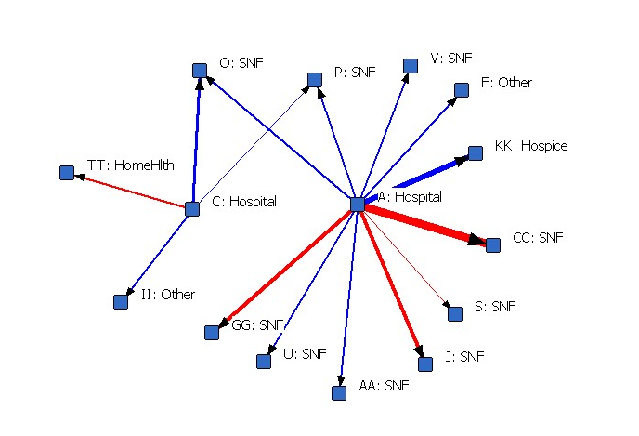
Social Network Analysis
Notes:
Those providers that experience 30 or more transitions between each other.
Other versions of the maps become more complex when fewer shared transitions are included

Slide 17
Community Specific Root Cause Analysis
Data Analysis
Coalition Readmission rates
Coalition Admission rates
Hospital Readmission rates
ED visit Rates
Observation Stay Rates
Mortality Rates
Post acute care setting Readmission rates
Disease specific readmission rates
Process Mapping
Chart Reviews
Patient/Stakeholder feedback

Slide 18
Additional Assistance for Communities not in a formal Care Transitions Program
Provide quarterly community readmission metrics
Host a State-wide Learning and Action Network
Participate in Care Transitions Learning Sessions
Use QIO developed tools and resources

Slide 19
The CCTP as Part of a Broader Initiative
Partnership for Patients: a nationwide public-private partnership that will help improve the quality, safety, and affordability of health care for all Americans.
By the end of 2013:
40% Reduction in Preventable Hospital Acquired Conditions
1.8 Million Fewer Injuries
60,000 Lives Saved
20% Reduction in Preventable 30-Day Readmissions
1.6 Million Patients Recover Without Readmission
Up to $35 Billion Dollars Saved in Three Years
19

Slide 20
Questions?
Detailed information on all CCTP sites may be found at:
http://innovation.cms.gov/initiatives/Partnership-for-Patients/CCTP/partners.html
Additional information is available on our website:
http://innovation.cms.gov/initiatives/Partnership-for-Patients/CCTP/index.html
For further questions, please email:
CareTransitions@cms.hhs.gov
20
Notes:
Ellen-Marie and Ray will moderate Q&A.
Ray will wrap up.

