Slide 1
Developing Videos for the Web
Heather Gwaltney
August 24, 2012, 10:45 a.m. - 12:15 p.m.
2012 MOWAA Annual Conference
Gaylord National Harbor Hotel
Notes:
[pull up YouTube videos]
Old Spice | The Man Your Man Could Smell Like, 30 sec., 44M hits:
http://www.youtube.com/watch?NR=1&feature=endscreen&v=owGykVbfgUEOld
Spice | Questions, 30 sec., 22M hits: http://www.youtube.com/watch?v=uLTIowBF0kE
Kevin Brady on Prudential's "Day One" Campaign: http://www.youtube.com/watch?v=0ZpdGvMmVzg
Prudential -- Day One: Karen Gustin, 3/2/12: http://www.youtube.com/watch?v=nNiSA1PiH74

Slide 2
agenda
Intro and what you want to achieve
Self-assessment of strengths and needs
The value of video
best practices examples
Tips and resources
Action plan exercise
Contact

Slide 3
how many of you…
have used an MOWAA PSA or other video clip?

Slide 4
have…
done your own video work?

Slide 5
were…
in my previous E-strategy session?

Slide 6
introduction
Heather Gwaltney
Over 15 years experience in marketing-communications and video industry
Teach at George Mason University
Undergrad Psych/Business; Grad OD
Consulting focus is on human rights and environmental issues

Slide 7
agenda
Introduction and what you want to achieve
Self-assessment of strengths and needs
The value of E-strategy and social networks
Best practice examples
Tips and resources
Action plan exercise
Contact

Slide 8
my goal
Intention and goals for today
Safe space to question, experiment and have some fun
“Whatever is said in the room stays in the room”
Integrate my own external knowledge with existing MOW knowledge

Slide 9
what you need from today
Notes:
[capture on computer, whiteboard or flipchart]
This helps me understand where I may need to further customize what I’m saying
I will also be able to tell you what out of your list will be addressed

Slide 10
defining web video
A short movie less than 10 minutes long that is distributed through an online channel
Notes:
How many of you have participated in a viral marketing campaign? If so, discuss why you participated and your evaluation of the viral campaign from the company or brand’s perspective. If you have not participated in a viral campaign, what type of incentive would it take for you to participate? How effective do you think viral campaigns are with consumers in your market segment?
The easiest and most cost effective way to start is by 1st go internally for the tools. to MOW’s website to see what video PSA’s are already available. Costs are…they refresh every…You can get them by…Most popular is
Obtain a toolkit by going to membership at….
If you find you need something more customized or have been given a budget to create video, then you look outside. Good sources are:
Local universities and Jr. colleges for film students
Film associations, such as Bay Area Women and Film; San Francisco Film Society, Women in Film and Video, Kevin’s referral. These are based on the west and east coasts, but you can say you’re looking for people in a particular region.
Expect to pay $1,000-$2,000 per minute if you use a professional out of school for good production quality; no less than $1,000 for even a 30-sec. PSA. Anything less than 2 mins. Is actually difficult to do.
Embed your video in existing online channels, such as your website, blog and/or social media channels (such as FB, twitter and YouTube).
Distribution is everything! You must understand the demographics of your audience. For instance, if you are fundraising, you will reach a small business owner differently than an individual donor.

Slide 11
types of web video
PSA’s
Educational
Personal stories
Call-to-action
Promotional
Notes:
How many of you have participated in a viral marketing campaign? If so, discuss why you participated and your evaluation of the viral campaign from the company or brand’s perspective. If you have not participated in a viral campaign, what type of incentive would it take for you to participate? How effective do you think viral campaigns are with consumers in your market segment?
The easiest and most cost effective way to start is by 1st go internally for the tools. to MOW’s website to see what video PSA’s are already available. Costs are…they refresh every…You can get them by…Most popular is
Obtain a toolkit by going to membership at….
If you find you need something more customized or have been given a budget to create video, then you look outside. Good sources are:
Local universities and Jr. colleges for film students
Film associations, such as Bay Area Women and Film; San Francisco Film Society, Women in Film and Video, Kevin’s referral. These are based on the west and east coasts, but you can say you’re looking for people in a particular region.
Expect to pay $1,000-$2,000 per minute if you use a professional out of school for good production quality; no less than $1,000 for even a 30-sec. PSA. Anything less than 2 mins. Is actually difficult to do.
Embed your video in existing online channels, such as your website, blog and/or social media channels (such as FB, twitter and YouTube).
Distribution is everything! You must understand the demographics of your audience. For instance, if you are fundraising, you will reach a small business owner differently than an individual donor.

Slide 12
self-assessment
Rate yourself/your program on a scale from 1 to 5 (1 being the lowest and 5 being the highest) on all of the items listed on your self-assessment
Notes:
Before I continue to talk, let’s do a self-assessment, so you understand three main things:
What goes into a strong web video
Where you may already excel in the video creation process
Where you can use the most guidance and support

Slide 13
self-assessment
Where were people getting 1’s and 2’s?
How about 4’s and 5’s?
Notes:
Where were people getting 1’s and 2’s? This will help you determine what to focus on our action planning exercise at the end of the class
How about 4’s and 5’s? These are validation of what your strengths already are

Slide 14
video objectives
Increase awareness
Drive traffic to your website
Build a following
Generate revenue
Incite people to act
Notes:
Items 1 through 3: Increasing awareness, generating revenue and generating leads – those are all the typical objectives you find in any marketing-communications plan.
What’s different are items 4 through 7, which are specific to E-strategy and the use of online tools.

Slide 15
video distribution channels
Facebook and Twitter
Blogs
Electronic newsletters
Email
YouTube
Vimeo
DVD
Notes:
Most of these are also E-strategy channels; they can be used to distribute your web video
Distribution is key because
What’s also critical is that you are very clear about what your objectives are and how the tools will help you before using the tools.
Facebook = good for deals, updates, video clips and TV ads; marketing/outreach materials; call to action; educational info.; cry for help or support
Twitter = referred to as a micro blogging platform; takes a max of 140 characters; you can use tweetscan or summerize.com to monitor what people are saying about a brand or company name; monitoring twitter can also help you respond to potential customer concerns and dissatisfaction.
Blogs = create 2-way communication with your customers; allows you to share information with them; creates a feedback loop where they can provide reviews for potential funders and customers and provide feedback to you; must monitor closely. Create your own blog and distribute on like-minded organizations’ blogs (as guest blogger). You can also include postings on email messages and electronic newsletters – offering it up as content for partners to redistribute
Electronic newsletters = increases brand awareness; drives traffic to your website; increases opportunities for funding
Email = customize content to your audience as much as possible; and integrate other social networks including video.
YouTube vs. Vimeo =

Slide 16
viral videos and campaigns
“Tivo gave us the joy of fast-forwarding through crappy 30-second spots, but YouTube gave us the ability to call up the spots we like” – Nick Summers, Newsweek
Notes:
Viral videos = a message or video that is digitally passed one from one person to the next. An newsweek article indicates that viral campaigns are becoming as equally important as TV ads and that more and more revenue is going into creating them by ad agencies. Historically, audiences would consume commercials and ads passively; now they have DVR machines that allow them to pass by them. They are pickier and want to chose what they see. Now audiences are “earned; not just bought”. While there is no clear definition of what makes a campaign or video viral; you know you are viral if you have 10 thousand or more likes on Facebook or over a million views on YouTube. Humor is typically the most effective ingredient; while political pieces are typically least effective.

Slide 17
why care? MOWAA survey results
Most contributions come from:
Clients = 95%
Individual donations (not clients) = 93%
Private grants = 82%
Special events = 79%
Local businesses = 77%
United Way funds = 61%
Donations, per direct mail campaigns = 55%
Notes:
Before we launch into the use of online tools, we must first understand why we are using them. -And who we need to reach with them.
These facts are based the 2011/2012 member survey
You can see here that over 55% of those surveyed receive funds from these sources.
Why is this data important?
How can it help you with your E-strategy? If you’re fundraising, these are your top audiences.
-And which audiences are you most likely to reach with online tools?

Slide 18
MOWAA survey results –cont-
Over half of the programs say that direct mail campaigns are most effective for fundraising
A little under half said special events are
Notes:
This tells you further that MOWAA programs range greatly in their budgets anywhere from about 150 thousand and a little under 2 million with about half of the programs having most success with direct mail campaigns and special events.
This tells you that if your objective is to raise funds, you may want to consider integrating your social network initiatives with direct mail campaigns and/or events.
In marketing, experts use a term “the multiplier effect” stating that you gain far better results by using two to three different forms of media than you can by using any one form on its own.

Slide 19
getting started
Identify your need and objective
Identify your audience and how they communicate
Decide whether or not to use existing WOWAA PSA’s and story
Use inside help, college interns or professionals
Integrate with other media
Distribute! Distribute! Distribute!
Track usage and success
Notes:
How to get free help
How to get low cost help
If you want high production quality or receive funding for this

Slide 20
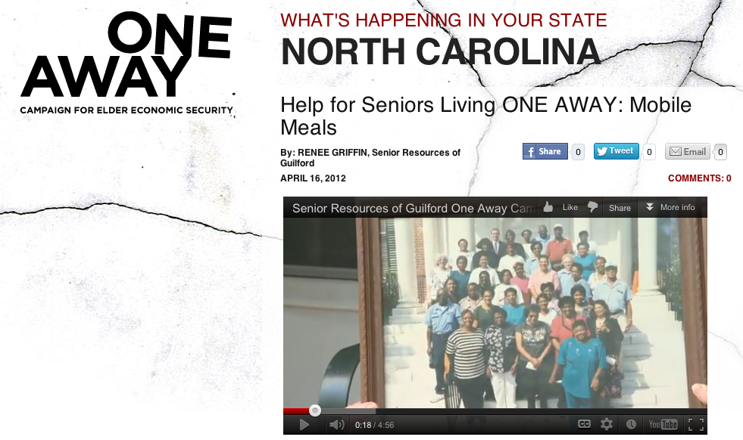
Notes:
a number of videos made for senior Resources in Guilford, Greensboro, SC. http://youtu.be/Wj36BeupvIU
5 mins.

Slide 21
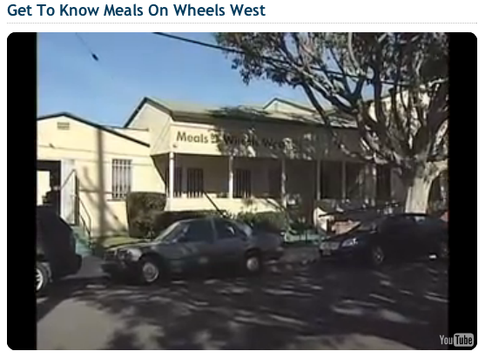
Notes:
Meals On Wheels West. http://www.youtube.com/watch?v=AXr5G18Cv6U&feature=player_embedded
2 mins.

Slide 22
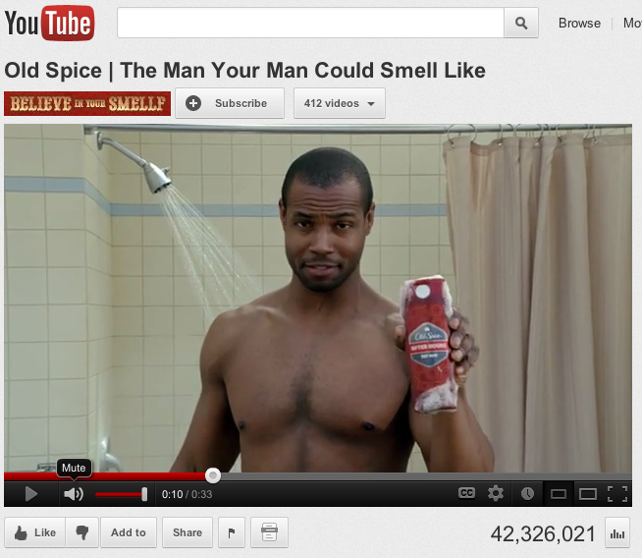
Notes:
[play video]
Old Spice | The Man Your Man Could Smell Like, 30 sec., 44M hits:
http://www.youtube.com/watch?NR=1&feature=endscreen&v=owGykVbfgUE

Slide 23
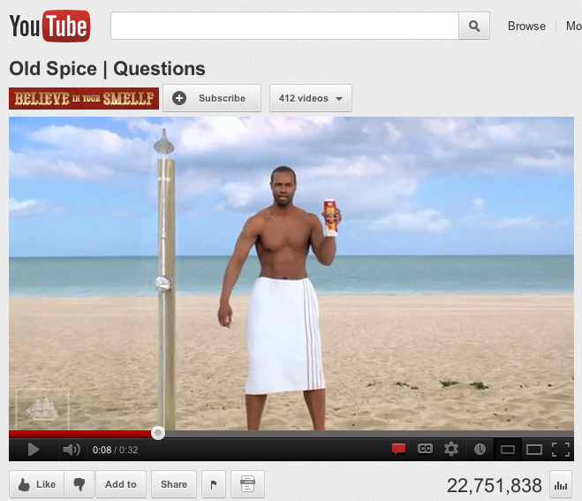
Notes:
[play video]
Old Spice | Questions, 30 sec., 22M hits: http://www.youtube.com/watch?v=uLTIowBF0kE

Slide 24
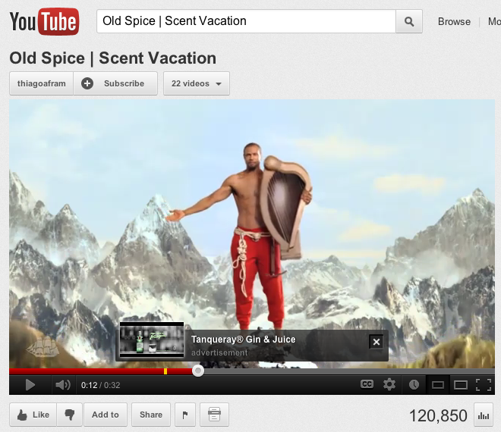
Notes:
Old Spice | Scent Vacation, 30 sec., 120,000 hits

Slide 25
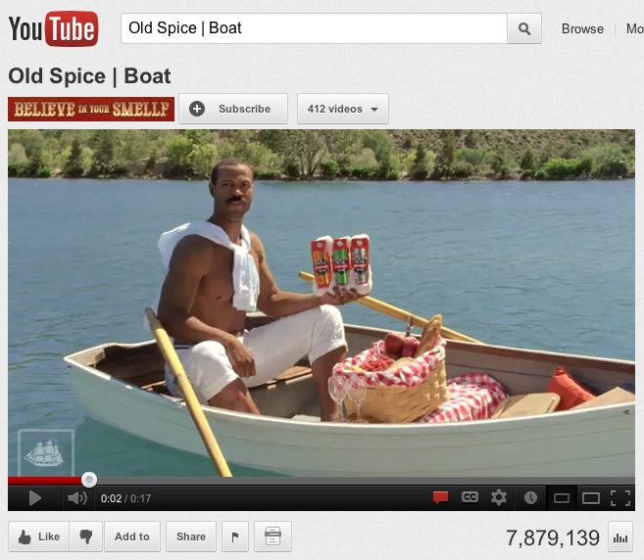
Notes:
Old Spice | Boat, 17 sec., 7.8M hits

Slide 26
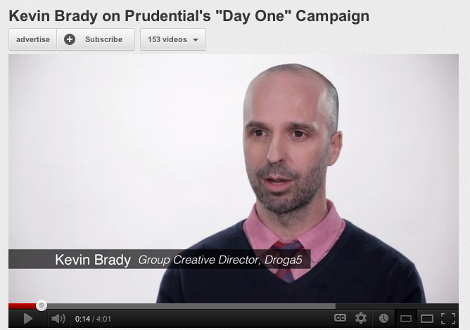
Notes:
[play video]
Kevin Brady on Prudential's "Day One" Campaign: http://www.youtube.com/watch?v=0ZpdGvMmVzg

Slide 27
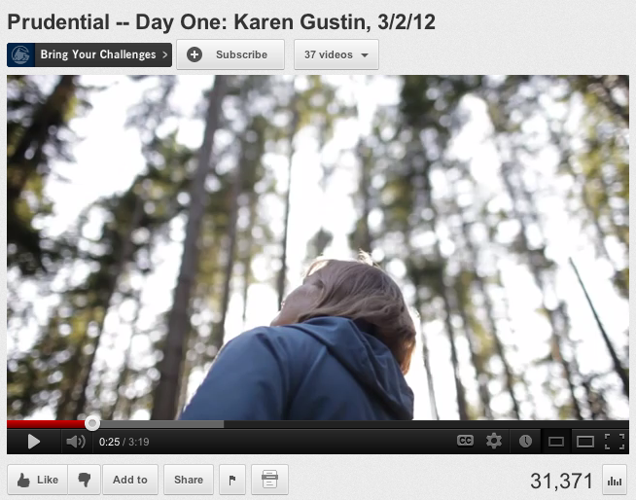
Notes:
[play video]
Prudential -- Day One: Karen Gustin, 3/2/12: http://www.youtube.com/watch?v=nNiSA1PiH74
3 mins, 30,000 views

Slide 28
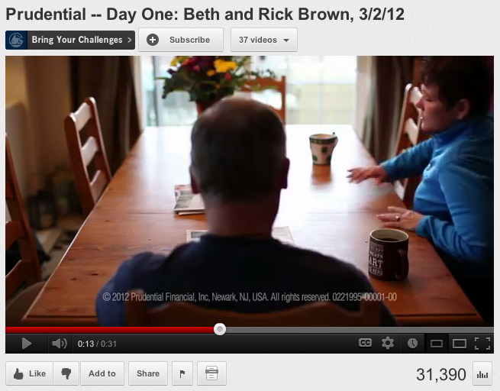
Notes:
Prudential -- Day One: Beth and Rick Brown, 3/2/12
30 seconds and nearly 32,000 views

Slide 29
Notes:
Prudential - Day One: Hermann Bouska, 7/1/11
30 seconds and nearly 22,000 views

Slide 30
why do you think these are effective?
list
Notes:
[note on computer, flip chart or whiteboard]

Slide 31
lessons learned
Notes:
So, we’ve discussed successes in web video.
What are some lesson learned in your own experience with video?

Slide 32
MOWAA resources
A video and radio PSA
Photos
Logos
Campaign Q&A and language
Social Media Tips & Tricks
Media Outreach Guide
Notes:
-And here are some resources available to you internally that can help you achieve your objectives.
Remember to always go inside first before re-inventing the wheel.
MOWAA has done an excellent job of creating tools for you at little to no charge

Slide 33
external resources
Notes:
These are some external resources available to you.
[Go through each]
YouTube
Vimeo
Wifv
AFI

Slide 34
action plan exercise
Select spokesperson
Form groups of 4 or 5 around your seats
Select one section on your action plan outline that you’d like help with
Each person get’s two minutes for the group to help them with the one action plan item
Rotate until each person has received advice
Spokespersons report back key findings for groups
Notes:
Now that we’ve talked a lot and you know what your strengths and needs are, let’s apply this knowledge to a plan outline that you can use moving forward.

Slide 35
stay connected
MOWAA LinkedIn community group: linkedin.com/groups?gid=4304589
Membership: membership@mowaa.org or call Emily Persson and Logan Goulett at 703-548-5558
Heather Gwaltney: http://BullsEyeCommunications.TV
Notes:
MOWAA has recently created a LinkedIn account for members. I highly encourage you to join (if you haven’t already), to utilize it for asking questions to your community and sharing your own knowledge.
Membership can be reached by email or phone.
-And if you want to stay in touch with me, I’ve listed my website address here.

Slide 36
Q & A
Any questions?
Notes:
Were there any last minute burning questions before we close?
Thank you all for coming today, and good luck out there!

