Slide 1
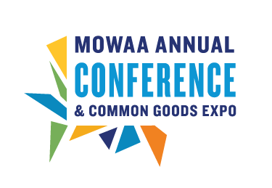
Advanced E-Strategy
Heather Gwaltney
August 22, 2012, 9:00 a.m. - 10:30 a.m.
2012 MOWAA Annual Conference
Gaylord National Harbor Hotel
Notes:
2007 UNICEF's Tap Project, 5 mins., 300,000 views: http://www.youtube.com/watch?v=3OmN4B7yyS8

Slide 2
how many of you…
are satisfied with your E-Strategy?

Slide 3
could…
really use help with your E-strategy?

Slide 4
are…
clear about what an E-strategy is?

Slide 5
introduction
Heather Gwaltney
Over 15 years experience in marketing-communications and video industry
Teach at George Mason University
Undergrad Psych/Business; Grad OD
Consulting focus is on human rights and environmental issues

Slide 6
agenda
Introduction and what you want to achieve
Self-assessment of strengths and needs
The value of E-strategy and social networks
Best practice examples
Tips and resources
Action plan exercise
Contact

Slide 7
my goal
Intention and goals for today
Safe space to question, experiment and have some fun
“Whatever is said in the room stays in the room”
Integrate my own external knowledge with existing MOW knowledge

Slide 8
what you need from today
Notes:
[capture on computer, whiteboard or flipchart]
This helps me understand where I may need to further customize what I’m saying
I will also be able to tell you what out of your list will be addressed

Slide 9
defining E-strategy
E-strategy: how to utilize online tools and social networks to achieve program objectives
Notes:
This is how I’m defining E-strategy today. I will also be using the terms communications channels, online tools, social media and social networks. E-strategy is the strategy or how you integrate your online tools to meet your objectives.
Online tools and online communications channels can be considered the same things
Social media and social networks can be considered the same as well

Slide 10
6,000 foot view of E-strategy
Changes the way customers communicate and interact with companies
Creates ‘real time’ communications
Enhances customer service
Resolves issues with clients
Notes:
Changes the way customers communication and interact with companies
Creates ‘real time’ communications
Can use it to enhance customer service through things such as instant messaging
Can use it to resolve issues with clients, such as complaints on twitter and blogs

Slide 11
self-assessment
Rate yourself/your program on a scale from 1 to 5 (1 being the lowest and 5 being the highest) on all of the items listed on your self-assessment
Notes:
Before I continue to talk, let’s do a self-assessment, so you understand three main things:
What goes into a strong E-strategy
Where you already excel with social networking and online tools
Where you can use the most guidance and support

Slide 12
self-assessment
Where were people getting 1’s and 2’s?
How about 4’s and 5’s?
Notes:
Where were people getting 1’s and 2’s? This will help you determine what to focus on our action planning exercise at the end of the class
How about 4’s and 5’s? These are validation of what your strengths already are

Slide 13
E-strategy objectives
Increase awareness
Generate revenue
Generate leads
Build loyalty and a following
Expand email list
Collect personal data
Increase web usage
Notes:
Items 1 through 3: Increasing awareness, generating revenue and generating leads – those are all the typical objectives you find in any marketing-communications plan.
What’s different are items 4 through 7, which are specific to E-strategy and the use of online tools.

Slide 14
E-strategy channels
Facebook
Twitter
Blogs
Electronic newsletters
Email
Search Engine Optimization (SEO)
Viral videos
Notes:
-And these are the types of online tools and social networks that companies use to achieve those objectives.
What’s also critical is that you are very clear about what your objectives are and how the tools will help you before using the tools.
Facebook = good for deals, updates, video clips and TV ads; marketing/outreach materials; call to action; educational info.; cry for help or support
Twitter = referred to as a micro blogging platform; takes a max of 140 characters; you can use tweetscan or summerize.com to monitor what people are saying about a brand or company name; monitoring twitter can also help you respond to potential customer concerns and dissatisfaction.
Blogs = create 2-way communication with your customers; allows you to share information with them; creates a feedback loop where they can provide reviews for potential funders and customers and provide feedback to you; must monitor closely. Create your own blog and distribute on like-minded organizations’ blogs (as guest blogger). You can also include postings on email messages and electronic newsletters – offering it up as content for partners to redistribute
Electronic newsletters = increases brand awareness; drives traffic to your website; increases opportunities for funding
Email = customize content to your audience as much as possible; and integrate other social networks including video.
Search Engine Optimization (SEO) = If your site is on the top 10 list, traffic and increase 9 times; register with search engines and pay for placement fee; tag content in site with key phrases; pay for search ads
Viral videos = a message or video that is digitally passed one from one person to the next. An newsweek article indicates that viral campaigns are becoming as equally important as TV ads and that more and more revenue is going into creating them by ad agencies. Historically, audiences would consume commercials and ads passively; now they have DVR machines that allow them to pass by them. They are pickier and want to chose what they see. Now audiences are “earned; not just bought”. While there is no clear definition of what makes a campaign or video viral; you know you are viral if you have 10 thousand or more likes on Facebook or over a million views on YouTube. Humor is typically the most effective ingredient; while political pieces are typically least effective.

Slide 15
most commonly used online communications channels
Source: Quoted by Clow & Baack from Larry Jaffee’s, “Follow the Money.”
Notes:
Here you can see a breakdown of how many companies are using these channels to achieve their goals or objectives.
The top three channels used are Email, E-newsletters and Blogs.
Something to pay extra attention to is not just how you use these channels to support your own objectives, but which channels your audience uses to communicate.
You can use all of the channels you want – even with great, effective content and messaging, but if your audience doesn’t use the tool themselves, they’ll never see it.
So, another question you want to ask yourself is “how are my clients receiving news and information? How do they communicate? Which online channels do my potential funders use?”

Slide 16
how companies use the channels to meet objectives
Source: Quoted by Clow & Baack from Larry Jaffee’s, “Follow the Money.”
Notes:
As you can see here, most companies use online channels to generate revenue, drive traffic to their website and expand their audience by building their email lists.
Fewer companies also use them to generate leads and offer incentives.

Slide 17
why care? MOWAA survey results
Most contributions come from:
Clients = 95%
Individual donations (not clients) = 93%
Private grants = 82%
Special events = 79%
Local businesses = 77%
United Way funds = 61%
Donations, per direct mail campaigns = 55%
Notes:
Before we launch into the use of online tools, we must first understand why we are using them. -And who we need to reach with them.
These facts are based the 2011/2012 member survey
You can see here that over 55% of those surveyed receive funds from these sources.
Why is this data important?
How can it help you with your E-strategy? If you’re fundraising, these are your top audiences.
-And which audiences are you most likely to reach with online tools?

Slide 18
MOWAA survey results –cont-
Most MOWAA programs have a budget of $150K-1.9M
Over half of the programs say that direct mail campaigns are most effective for fundraising
A little under half said special events are
Notes:
This tells you further that MOWAA programs range greatly in their budgets anywhere from about 150 thousand and a little under 2 million with about half of the programs having most success with direct mail campaigns and special events.
This tells you that if your objective is to raise funds, you may want to consider integrating your social network initiatives with direct mail campaigns and/or events.
In marketing, experts use a term “the multiplier effect” stating that you gain far better results by using two to three different forms of media than you can by using any one form on its own.

Slide 19
MOWAA survey results –cont-
“How often do you personally use social networking sites (e.g. Facebook, Twitter)?”
45% say several times a day
17% say several times a week
16% say never
Notes:
How many of you fall in the top two categories?
How many in the 3rd one?
Why are you using the social media?
What kind of results are you getting?
Why aren’t you using it?
I haven’t read anything about the proper frequency of using your social networks. I think it’s important to use it ongoing to keep content fresh, but I also believe that the content, messaging and list of followers are far more important than frequency, especially if you’re talking about the difference between being on Facebook and Twitter several times a day vs. several times a week.

Slide 20
best practices
“We have used Facebook to get messages out about our needs…
…we made a request for heaters and received $600 and 16 heaters…
...We have sent out requests for drivers, sent weather alerts, and posted information about upcoming events. All have been successful.”
– MOWAA program survey participant
Notes:
Here you have an example of how Facebook is being successfully used by one of the MOWAA programs that responded to the survey we discussed earlier.
How many of you are already on on Facebook? Why or why not? If you are on FB, how much time do you spend online there?
What about twitter? Why or why not?
Based on your experience with FB and twitter, how can companies use them to reach you?
Are you a fan of any company on FB? If so, why did you become a fan? If not, why did you choose not to become a fan?

Slide 21
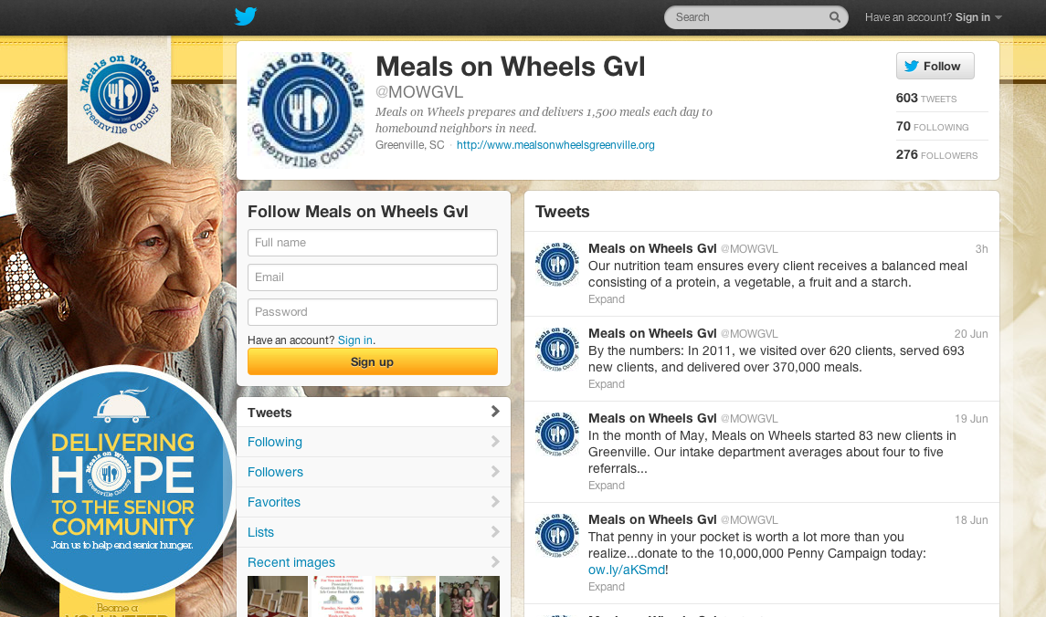
Social media best practices
Meals on Wheels twitter, Greenville County, SC
Notes:
MOWAA of Greenville County has a successful twitter page with over 600 tweets and nearly 300 followers.
Note that they also used one of MOWAA’s existing photos for their page.
https://twitter.com/#!/MOWGVL
How to get free help: put an announcement out to a local college or university for a voluntary internship position (college students want the experience and to build their resume. They are also part of they Y generation and therefore social media is natural for them to use). Also, put a posting out to national video and media associations and LinkedIn groups. Recirculate existing content from MOW.
How to get low cost help: Hire entry level people. I work for a client that pays a project assistant $9/hour to manage our social media.

Slide 22
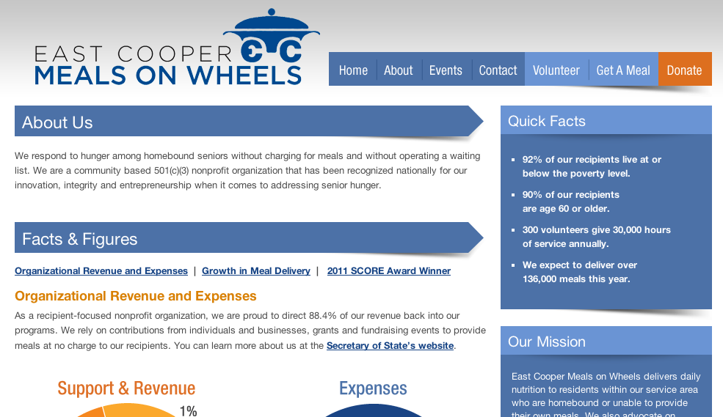
Social media best practices
Meals on Wheels website, Mount Pleasant, SC
Notes:
MOWAA’s of Mount Pleasant, South Carolina has a clear robust online presence with their website.
http://www.ecmow.org/

Slide 23
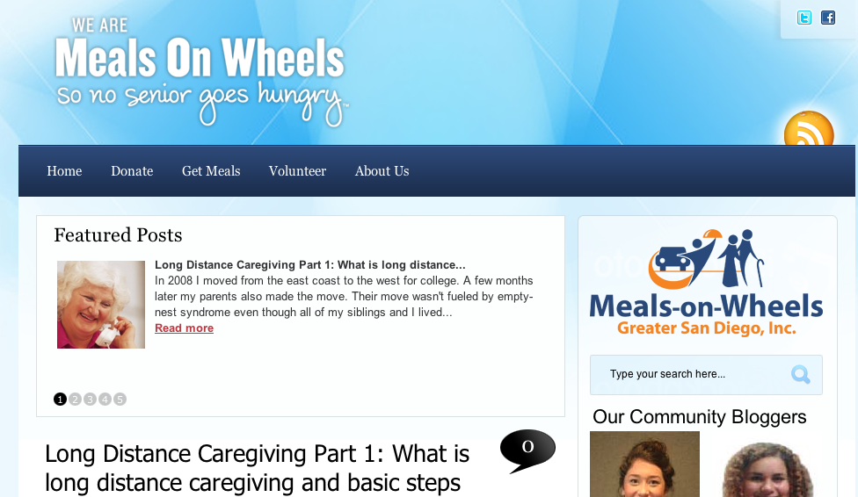
Social media best practices
“Greater San Diego, Inc.”
Meals on Wheels Community blog, San Diego, CA
Notes:
-And here’s an example of how the Meals-on-Wheels of Greater San Diego is utilizing a community blog.
http://www.meals-on-wheels.org/

Slide 24
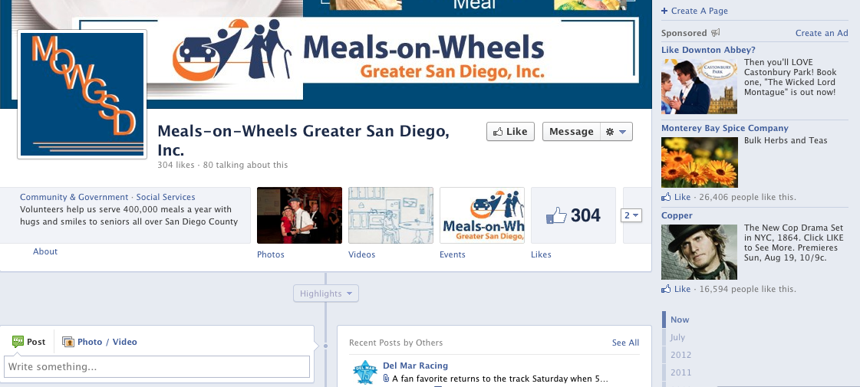
Social media best practices
“Greater San Diego, Inc.”
Meals on Wheels facebook, San Diego, CA
Notes:
Same Greater San Diego Meals-on-Wheels has a successful presence on Facebook with over 300 likes.
http://www.meals-on-wheels.org/

Slide 25
outside of MOWAA
75% of Internet users participate in some kind of social media
Facebook alone has over 300M users worldwide
Notes:
When you go outside of MOW, you find that 75% of Internet users participate in some kind of social media Facebook alone has over 300M users worldwide

Slide 26
Estimated media reach 80 million
Estimated earnings $100,000 in one day
4 million children were provided clean water
Notes:
This is a successful campaign created by ad agency, Droga5 for Unicef’s “Tap Project”.
They did an excellent job of integrating their E-strategy and online tools with tradition forms of media and PR.
[play video]
2007 UNICEF's Tap Project, 5 mins., 300,000 views: http://www.youtube.com/watch?v=3OmN4B7yyS8
This campaign yielded Unicef:’
An estimated media reach 80 million
estimated earnings $100,000 in one day, and
Clean water for 4 million children

Slide 27
why do you think these are effective?
list
Notes:
[note on computer, flip chart or whiteboard]

Slide 28
lessons learned
What are some?
Notes:
So, we’ve discussed successes in social networks.
What are some lesson learned in your own experience with E-strategy and using social media?

Slide 29
tips
Define your objective up front
Apply baseline metrics and tracking mechanisms
Focus your message on key service
Identify why your audience would care and their behaviors
Make your message personal
Offer an incentive
Match your message, channel and distribution to your audience
Measure and celebrate success!
Notes:
Here is a sequence of steps you can follow to build a strong E-strategy.
Define your objective up front (e.g. educate, gain clients, raise funds)
Apply baseline metrics and tracking mechanisms (e.g. Google analytics
Focus your message on key service
Identify why your audience would care and their behaviors
Make your message personal
Offer an incentive (e.g. giveaway and/or information)
Match your message, channel and distribution to your audience
Measure and celebrate success!
I’ve also put together a single sheet of these tips, along with some of the resources we’re about to look at. You can take it home with you (if you haven’t printed it out already from the website)

Slide 30
MOWAA resources
Grant Opportunities
Social Media Tips & Tricks
A video and radio PSA
Newsletter templates (printed and digital)
Letterhead template and logos
Campaign Q&A and language
Media Outreach Guide
Sample Press Materials
Notes:
-And here are some resources available to you internally that can help you achieve your objectives.
Remember to always go inside first before re-inventing the wheel.
MOWAA has done an excellent job of creating tools for you at little to no charge

Slide 31
external resources
Notes:
These are some external resources available to you.
All of them are available (at least at some level) for no charge, except for GoDaddy.
[Go through each]
YouTube
Vimeo
Facebook
Twitter
Weebly, iWeb and Wordpress (website and blog)
GoDaddy (domain name and web hosting)
MailChimp and Constant Contact (email newsletters)
Google Reader (email and news alerts)

Slide 32
action plan exercise
Select spokesperson
Form groups of 4 or 5 around your seats
Select one section on your action plan outline that you’d like help with
Each person get’s two minutes for the group to help them with the one action plan item
Rotate until each person has received advice
Spokespersons report back key findings for groups
Notes:
Now that we’ve talked a lot and you know what your strengths and needs are, let’s apply this knowledge to a plan outline that you can use moving forward.

Slide 33
stay connected
MOWAA LinkedIn community group: linkedin.com/groups?gid=4304589
Membership: membership@mowaa.org or call Emily Persson and Logan Goulett at 703-548-5558
Heather Gwaltney: http://BullsEyeCommunications.TV
Notes:
MOWAA has recently created a LinkedIn account for members. I highly encourage you to join (if you haven’t already), to utilize it for asking questions to your community and sharing your own knowledge.
Membership can be reached by email or phone.
-And if you want to stay in touch with me, I’ve listed my website address here.

Slide 34
Q & A
Any questions?
Notes:
Were there any last minute burning questions before we close?
Thank you all for coming today, and good luck out there!

