Slide 1
Developing, Cultivating and
Maintaining
Relationships with Foundations

Slide 2
Session at a Glance
Foundation Overview
Current Trends in Grantmaking
Grantmaking Process
Funder Compatibility - Finding the Right Match
What Foundations Look For When Making an Investment
Approaching a Foundation
Maintaining a Foundation Relationship

Slide 3
Foundation Overview.

Slide 4
One foundation is one foundation
You are not the only nonprofit foundations are working with
Not long term support
Foundations invest in the Future

Slide 5
In 2010 over $290 Billion was given to non-profits in the United States
Source: Giving USA
73% Individuals
14% Foundations
8% Bequests
5% Corporations

Slide 6
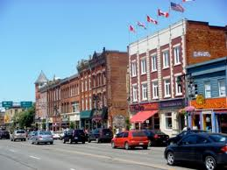
Types of Foundations
Types of Foundations
Family Foundation
Family members play a significant role in decision making
Giving is aligned with values and interests of family
Corporate Foundation
Geographic connection
Aligned with corporate citizenship
goals and values
Community Foundation
Supports organizations and programs in a specific
geographic location
Focus is on local and regional needs

Slide 7
Current Trends in Foundations.

Slide 8
The Economy and Effect
Giving Capacity
Grant Scrutiny

Slide 9
The Economic Impact
Decrease in Number of Grants Awarded
Decrease in Size of Grant Amounts
Decrease in the Number of New Grantees
Decrease in the Number of Multi-Year Grants
Decrease in Capital Grants
Invitation only
Reassessment of priorities
Accountability emphasis
Foundation Center
2010 Foundation Growth and Giving Estimates
1,300 Foundation Respondents

Slide 10
The Grantmaking Process.

Slide 11
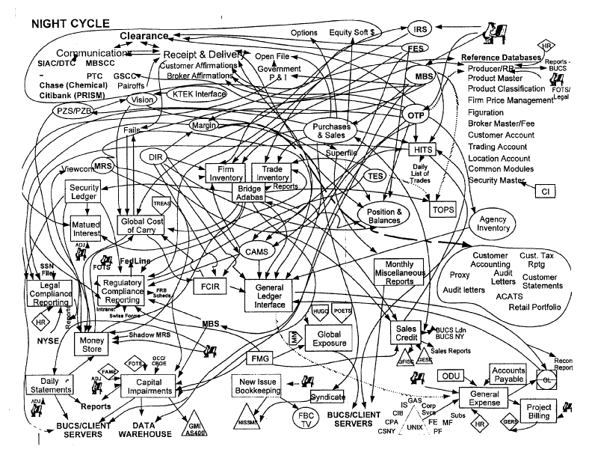
Navigating the Foundation Maze
YOU
ARE
HERE

Slide 12
Working with Foundations Takes Time
Identification
Initial Approach
Paperwork submission
Review
Decision
Follow-up
6-12 months

Slide 13
Funder compatibility.
What Foundations Look For When Making an Investment.

Slide 14
The Right Fit.

Slide 15
Interest
Geographic Area
Priority Focus
Population Served

Slide 16
Type
Direct Service Providers
Intermediaries
Advocacy

Slide 17
Type
Life Stage
New Growth Mature Turnaround
Direct Service Providers
Intermediaries
Advocacy

Slide 18
Identifying Foundations
Finding the Right Match
Peer Research
Senior Centers
Community Centers
Hospice
Food Banks
Hospitals
Foundation website
Grant Guidelines
Annual report
IRS Form 990
www.guidestar.org
www.foundationcenter.org

Slide 19
Seniors
Health
Vulnerable Populations
Food
Quality of Life
Civic Engagement
Nutrition
Self sufficiency

Slide 20
Homework
Interest areas
Geographic area served
Types of Organizations
Award ranges
Operating, program, capital support
Primary foundation contact

Slide 21
Questions Foundation Staff Ask When Reviewing Requests
How are they different than….?
Are they making an impact?
Will a grant really make a difference?
How effective is there leadership?
Do they have the capacity to implement?
How will this request be sustainable?
Who else is supporting them?
Is the organization a good community partner?
What is the track record of success?
Is this a high quality program?
is the organization meeting a community need?

Slide 22
The Challenge
Helping a Foundation Understand the Purpose of Your Organization and the Need for Its Existence

Slide 23
Approaching a Foundation.

Slide 24
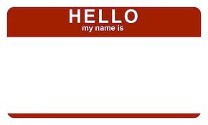
Meals On Wheels

Slide 25
Email
Phone Call
Facilitated introduction

Slide 26
Goals | Personal connection
1 Introduce yourself, organization
and project
2 Explore fit with interests and
get a reaction of funding probability
3 To identify next steps:
Meeting
Site visit
Invitation to apply
*Reminder: Be sure to allow plenty of time. The average foundation process
from introduction to funding can take 6-12 months.

Slide 27
What do I say?
“My name is Joanna Nixon and I’m calling on behalf of Meals on Wheels of Jackson County.
I have reviewed your grantmaking guidelines and see your foundation has an interest in nutrition, seniors and self-sufficiency.
Our mission is to x and we provide 2 meals a day to over 75 low-income seniors a week in rural Jackson County. I think our x program might be of interest to the foundation, I was wondering if I could schedule a time to meet with you and tell you more about the impact we are making in the lives of low-income seniors.”

Slide 28
Possible Responses
Set-up a meeting
Set-up a site visit
Submit more information
Submit a letter of inquiry
Submit a application or proposal
No response to email or phone call
“Not of interest at this time.”
Find out why
Explore the possibility of future
funding
Keep the funder informed of your
work
No usually means
“not now” “not ever”

Slide 29
Meeting
A foundation is looking to build knowledge of your organization, see evidence of the strength of your program and meet the leadership
of your organization
1 Find out in advance what a foundation staff person wants to
see or learn
2 Differentiate your organization
3 Involve your Board, a volunteer or program participants
4 Ask Advice

Slide 30
By the Numbers
Meals on Wheels At A Glance
Established in 1990
4 Full-time staff 2 part-time staff
1,500+ seniors served each year
7 Pennsylvania counties served
$500,000 annual budget
Board of Directors
Board member name Affiliation
Board member name Affiliation
Board member name Affiliation
Board member name Affiliation
Board member name Affiliation
Board member name Affiliation
Partners
Jackson County Hospital
Jackson Senior Center
Riverview Hospital
Tri-County Community Center
Alexander Mental Health
Revenue Sources
Meals on Wheels of Jackson County
25 S. Illinois Ave.
Alexandra, PA 69870
(xxx) xxx-xxxx
www.mealsonwheelsjackson.org
Executive Director: Sarah Cook

Slide 31
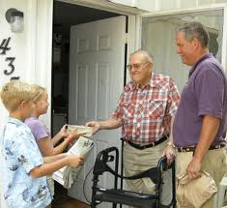
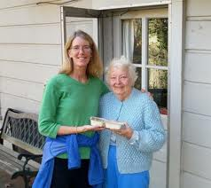
Meals on Wheels Overview
What We Do
Home Delivered Meals: 2 meals per day seven days a week
Nutrition Counseling
Social Work assessments and referrals
Intensive Case Management for over 300 clients per year
Preventative Home Safety Services including grab bars, railings and smoke detectors
Who We Serve
59% are age 75+
96% are low-income
79% have dietary restrictions
67% live alone
37% have a disability
2010 By the Numbers
375
Volunteers
12,000
Meals Delivered
1,800
Home Bound Seniors Served
7,800+ Seniors served since 1990

Slide 32
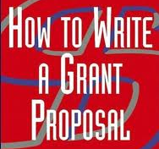
Avoid Common Mistakes
1 Submit the request that was discussed and for the amount provided
2 Meet Deadlines
3 Follow instructions (page limits, presentation)
4 Review for typos and make sure budgets add up correctly
5 Be honest and accurate about partnerships, supporters and costs

Slide 33
Maintaining a Relationship.

Slide 34
Maintaining a Relationship
1 Send thank you notes
2 Avoid gifts of appreciation
3 Provide periodic personalized
organization updates
4 Extend a personal invitation for a
follow-up site visit
5 Report back on your progress
6 Add foundations to your mailing list
7 Be proactive when something goes wrong
Stay in Touch

Slide 35
Questions?
Joanna Nixon, Strategy Consultant
jnixon@achieveguidance.com
www.achieveguidance.com
317.637.3000

