Slide 1


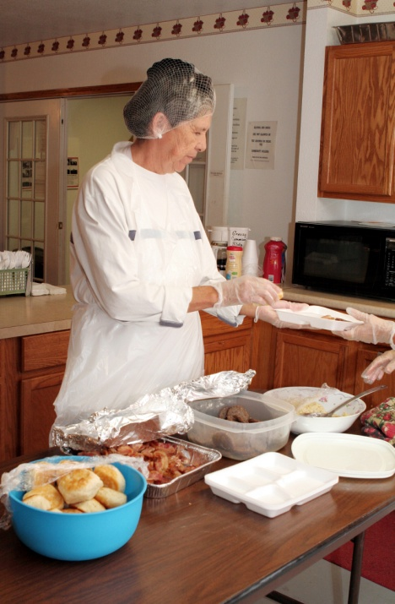

The 2010 Dietary Guidelines For Americans
Translating Research to Application
Jean L. Lloyd, National Nutritionist
MOWAA Conference
August 31, 2011
Notes:
1

Slide 2
Overview
Factors that influence our decisions about nutrition & physical activity
Nutrition Requirements of the Older Americans Act
Dietary Guidelines for Americans 2010 (DGAs)
Embedding Evidence Based Practice Into Nutrition Services
Resources

Slide 3
What influences what we eat?
Obesigenic Environment
Individual factors
  Age, gender, genetics, disability
  Knowledge, skills, attitude, beliefs, behavior
Environment
  Homes, schools, workplaces, senior centers, recreation facilities
  Foodservice and other retail food facilities, grocery stores

Slide 4
What influences what we eat?
Obesigenic Environment
Sectors of influence
  Government, public health & health care
  Agriculture
  Marketing, advertisements
  Industry: food, beverage, entertainment
  Community safety and design
Social & cultural values

Slide 5
What influences what we eat?
Obesigenic Environment
Social & cultural values
  Heritage, culture & traditions
  Religious beliefs
  Values of your society & family
  Beliefs about weight, use of free time, body image
  Lifestyle
  Priorities
  Time

Slide 6
Purpose of the OAA Nutrition Programs
Sections 330, 601
Reduce hunger & food insecurity
Promote socialization
Promote the health and well-being of older individuals and delay adverse health conditions through access to nutrition and other disease prevention and health promotion services

Slide 7



What are the Nutrition Program Requirements?
Sections 339, 601
2010 Dietary Guidelines for Americans
Dietary Reference Intakes
Food Safety Code

Slide 8
Program Implementation
Partially Federally funded, state administered program
Section 305 authorizes state administration, implementation varies
OAA does not allow the nutrition requirements to be waived if services funded with Title III C 1, C 2, or Nutrition Service Incentive Program dollars

Slide 9

Dietary Guidelines for Americans, 2010
  Executive Summary
  Chapter 1. Introduction
  Chapter 2. Balancing Calories to Manage Weight
  Chapter 3. Foods and Food Components to Reduce
  Chapter 4. Foods and Nutrients to Increase
  Chapter 5. Building Healthy Eating Patterns
  Chapter 6. Helping Americans Make Healthy Choices
  16 Appendices
Notes:
This slide shows the overall table of contents of the Dietary Guidelines for Americans, 2010. Note the prominence of “balancing calories to manage weight,” as the first scientific chapter of the document. The overweight/obesity epidemic was a strong factor in how the new DGAs are framed.
Also of note…for the first time, the Dietary Guidelines also clearly acknowledge the impact of the broader food environment on an individual’s dietary choices. Chapter 6 includes a call to action—a call for all sectors of society to realize that they can have an impact on improving the health of the nation.
9

Slide 10
What are the 2010 Dietary Guidelines for Americans (DGAs)?
Science based
Promote health/reduce chronic disease
Basis for federal nutrition programs & health care
Basis for individual healthy eating decisions
Updated every 5 years
Published by HHS & USDA

Slide 11
HHS/USDA Dietary Guidelines
Development Process
Phase 1: Dietary Guidelines Advisory Committee (DGAC)
13 member scientific advisory committee
Systematic evidence-based review methodology
6 public meetings/ comments throughout
445 page advisory report
www.dietaryguidelines.gov
Phase 2: Review and comment on DGAC Report
Public, 1159 comments; 50 organizations
USDA and HHS agencies
Phase 3: Drafting and review of Dietary Guidelines
Writing team: USDA and HHS nutritionists
Independent review and Departmental clearance of Policy document
Notes:
11
The Dietary Guidelines development process is an extensive one.
In phase one, an advisory committee of expert scientists is appointed to thoroughly review the body of current nutrition science. For the 2010 Guidelines, this committee of 13 members, with various areas of expertise within nutrition and health, was appointed in 2008. This committee posed, and systematically reviewed evidence for, 130 questions related to the relationship between nutrition and health. All information on the questions, the literature that was reviewed for each, and the rationale for the resulting conclusions is publicly available at www.nutritionevidencelibrary.gov. Throughout this process, six public meetings were held, and public comments were continually accepted. The committee organized all of their conclusions and recommendations into a comprehensive (400+ page) report, which was presented to the Secretaries of HHS and USDA in June, 2010.
Once the report is received, phase two begins. In phase two, the public-at-large as well as the agencies within USDA and HHS have an opportunity to provide comments on the report. All comments are reviewed and considered by the policy writing team. In total, over 2000 public comments were received throughout the 2010 Dietary Guidelines development process. A few hundred more were received from within government.
Phase three is when the science is translated into policy. In 2010, a small group of HHS and USDA nutritionists formed a writing team. The team carefully examined the Committee conclusions and recommendations, then boiled them down into the actual Dietary Guidelines for Americans policy document. 23 key recommendations for the general public were developed, as well as 6 key recommendations for special populations. The document was extensively reviewed and cleared through both Departments, up to the Secretary level.

Slide 12
Science: Evidence Based Library www.nutritionevidencelibrary.gov
130 Research Questions
Quality
Quantity
Objectivity
Consistency
Rigor
Integrity
Impact
Transparency
Generalizability
Evidence grades
  Strong
  Moderate
  Limited
  Expert opinion
  Grade not assignable

Slide 13
Science Basis For Dietary Guidelines
Dietary Reference Intakes
Food Pattern Modeling Analysis (USDA Pyramid System)
Consumption Data Analysis
1
Notes:
13
As mentioned, 130 research questions were posed by the 2010 DGA Committee. Available evidence for each question was systematically reviewed and the overall strength of the evidence was rated in order to develop appropriate conclusions.
Another 50 questions were addressed through other means, including food pattern modeling analyses, consumption data analyses, and statements from recent authoritative reports (e.g. Physical Activity Guidelines for Americans).

Slide 14
Dietary Guidelines for Americans, 2010
Diet-Related Chronic Diseases and Conditions
Obesity
Cardiovascular disease
Hypertension
Diabetes
Cancer
Osteoporosis
Notes:
As mentioned, the DGAs were developed with disease prevention in mind. On this slide, you see six chronic diseases and conditions commonly associated with dietary habits. Many of the questions that led to the development of the 2010 Guidelines were centered around these issues.
14

Slide 15
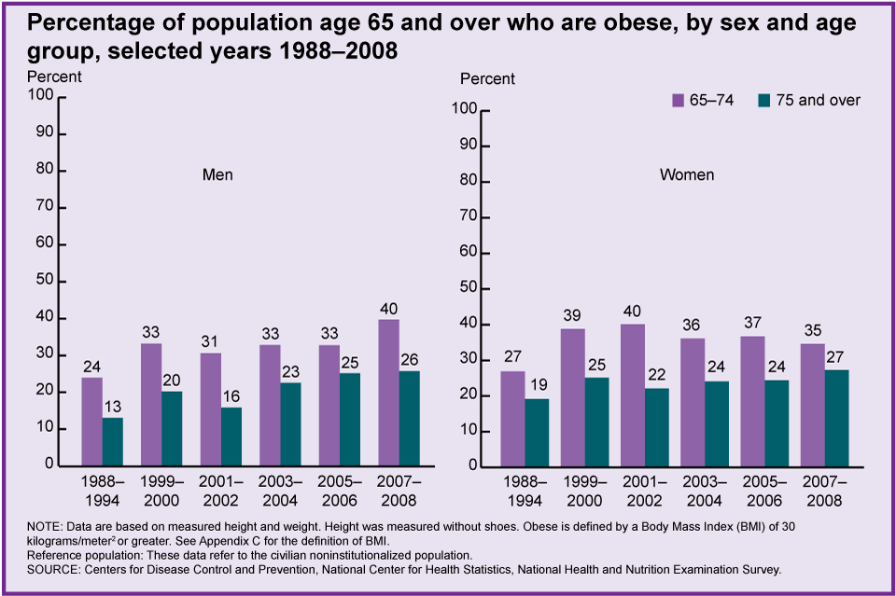
Obesity Prevalence for Older Adults Has Almost Doubled Since 1994
Notes:
15
This chart for Indicator 25 – Obesity – shows that the percentage of people age 65 and over who are obese has increased since 1988–1994. In 2007–2008, 32 percent of people age 65 and over were obese, compared with 22 percent in 1988–1994.

Slide 16
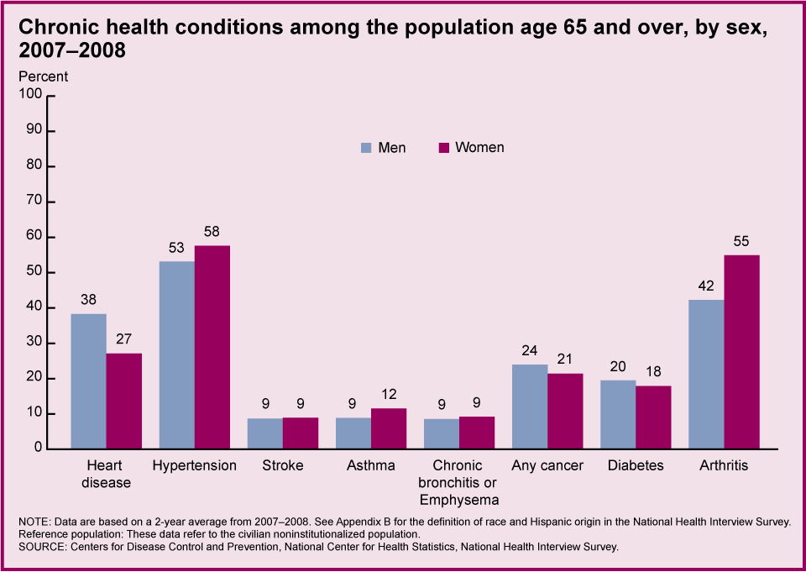
Nutrition Related Chronic Health Conditions of Older Adults
Notes:
16
This chart for Indicator 16 - Chronic Health Conditions – shows the percent of men and women reporting selected chronic conditions. Over half of men and women reported hypertension with arthritis and heart disease as the next most common conditions.

Slide 17
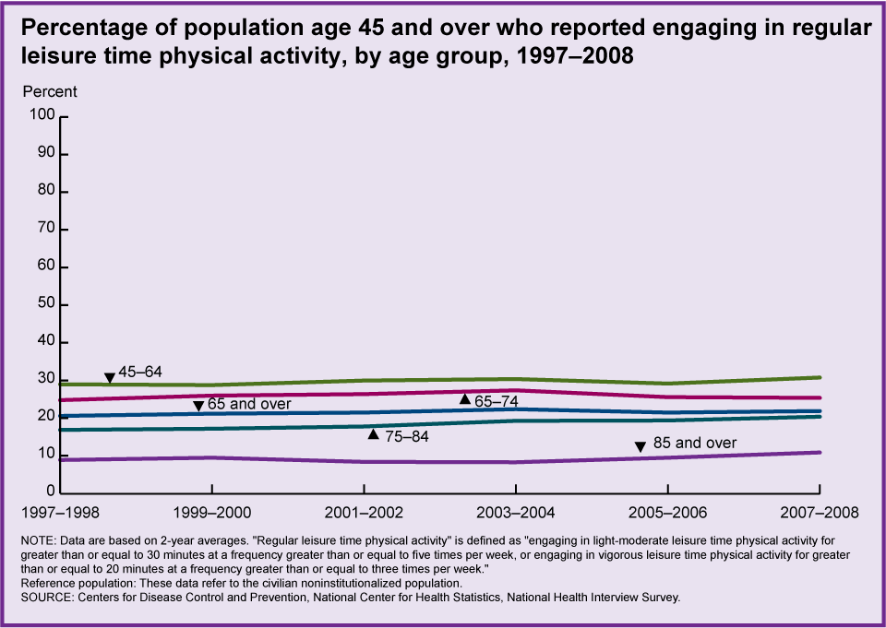
Physical Activity Declines as People Age
Notes:
17
This chart for Indicator 24 - Physical Activity – shows that in 2007–2008, 22 percent of people age 65 and over reported engaging in regular leisure time physical activity. The percentage of older people engaging in regular physical activity was lower at older ages, ranging from 25 percent among people age 65–74 to 11 percent among people age 85 and over. There was no significant change in the percentage reporting physical activity between 1997 and 2008.

Slide 18
OAA Nutrition Program Serves People with Nutrition Related Chronic Disease
Question | Home Delivered Meals % of Respondents | Congregate Meals % of Respondents
Heart Disease | 48 (32% nationally) | 32 (32% nationally)
Hypertension | 73 (48% nationally) | 68 (48% nationally)
Diabetes | 35 (18% nationally) | 26 (18% nationally)
Cancer | 19 (22% nationally) | 15 (22% nationally)
Osteoporosis | 30 | 21
2009 AoA Survey of OAA Participants, January, 2010

Slide 19
Dietary Guidelines for Americans, 2010
Overarching Concepts
Maintain calorie balance over time to achieve and sustain a healthy weight.
Focus on consuming nutrient-dense foods and beverages.
Modify behaviors at all ages to accomplish goal.
Notes:
The new 2010 Dietary Guidelines for Americans focus on balancing calories with physical activity, and encourage Americans to consume more healthy foods like vegetables, fruits, whole grains, fat-free and low-fat dairy products, and seafood, and to consume less sodium, saturated and trans fats, added sugars, and refined grains.
Boiled down, these are the two overarching themes of the 2010 Dietary Guidelines—messages are carried throughout the document.
19

Slide 20
Ch 2: Balancing Calories to Manage Weight
Key Recommendations
Prevent and/or reduce overweight and obesity through improved eating and physical activity behaviors.
Control total calorie intake to manage body weight. For people who are overweight or obese, this will mean consuming fewer calories from foods and beverages.
There is strong evidence that there is no optimal proportion of macronutrients for weight loss, it is overall caloric intake compared with physical activity.

Slide 21
Ch. 2: Balancing Calories to Manage Weight
Key Recommendations
Increase physical activity and reduce time spent in sedentary behaviors.
Implement recommendations from the 2008 Physical Activity Guidelines for Americans, http://www.health.gov/paguidelines/
Older adult minimum: 2.5 hours/moderate intensity aerobic activity/week plus strength training at least 2 times/week and flexibility & balance activity
Maintain appropriate calorie balance at all ages
Notes:
Key recommendations from chapter 2: balancing calories to manage weight
21

Slide 22

Key Recommendations
Physical Activity Guidelines for 65+
Older adults should follow the adult guidelines.
  They should be as active as their conditions allow.
  They should maintain/improve balance to prevent falling.
  They should match their activity level with their fitness level.
  They should monitor their safety in relation to their chronic conditions.

Slide 23
Definition: Nutrient Density for Food
  Provide vitamins, minerals, and other beneficial substances and relatively few calories without
    Solid fats in the food or added to it
    Added sugars
    Added refined starches
    Added sodium
    SoFAS or solid fats added sugars

Slide 24
Definition: Nutrient Density for Food
  Retain naturally occurring components, such as dietary fiber
  All vegetables, fruits, whole grains, seafood, eggs, beans and peas, unsalted nuts and seeds, fat-free and low-fat dairy, and lean meats and poultry are nutrient dense when prepared without solid fats or sugars

Slide 25
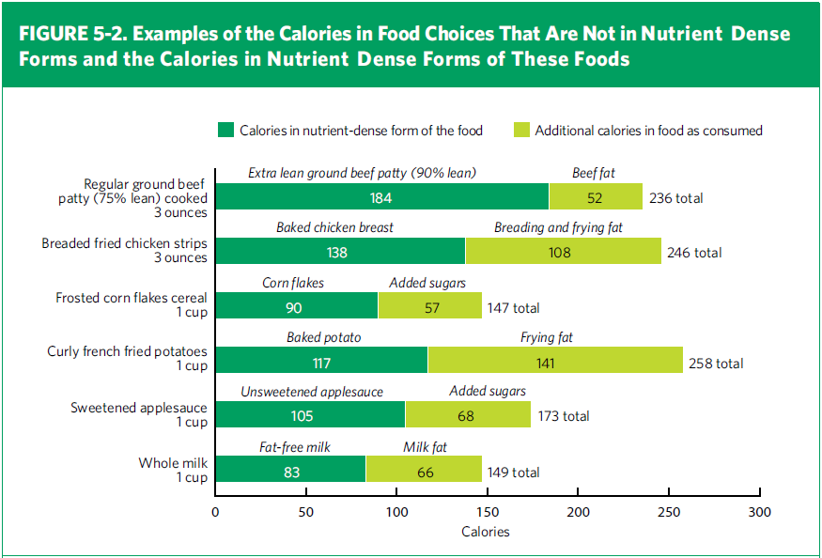
Nutrient Dense and Non-Nutrient Dense
Forms of Sample Foods

Slide 26

Principles for Promoting
Calorie Balance
Monitor food & beverage intake, physical activity & body weight
Reduce portion size
When eating out, make better choices
Limit screen time

Slide 27
Balancing Calories to Maintain Weight
Total calories for a day (see Table 2-3)
  Female, 51+ 1600-2200
  Male, 51+ 2000-2800
Physical Activity
  Activity ranges, sedentary, moderately active, active
Caloric range for Program meals – 1/3
  550 (sedentary female) to 900 (active male)
  Many programs average 700 calories/meal

Slide 28
Top Sources of Calories
Among Americans 2 Years and Older
1. Grain-based desserts
  Cake, cookies, pie, cobbler, sweet rolls, pastries, and donuts
2. Yeast breads
  White bread and rolls, mixed-grain bread, flavored bread, whole-wheat bread, and bagels
3. Chicken and chicken mixed dishes
  Fried and baked chicken parts, chicken strips/patties, stir-fries, casseroles, sandwiches, salads, and other chicken mixed dishes
4. Soda/energy/sports drinks
  Sodas, energy drinks, sports drinks, and sweetened bottled water including vitamin water
5. Pizza

Slide 29
Review
Control total caloric intake
Maintain appropriate caloric balance
Increase physical activity
Notes:
The Chapter 2 Key
Recommendations are listed here

Slide 30
Ch. 3: Foods and Food Components to Reduce
Key Recommendations
Reduce daily sodium intake to less than 2300 mg/day
Further reduce to 1500 mg/day if
  Age 51+
  African American
  Have hypertension, diabetes, chronic kidney disease
The 1500 mg recommendation applies to about half of the U.S. population, including children, and the majority of adults.

Slide 31
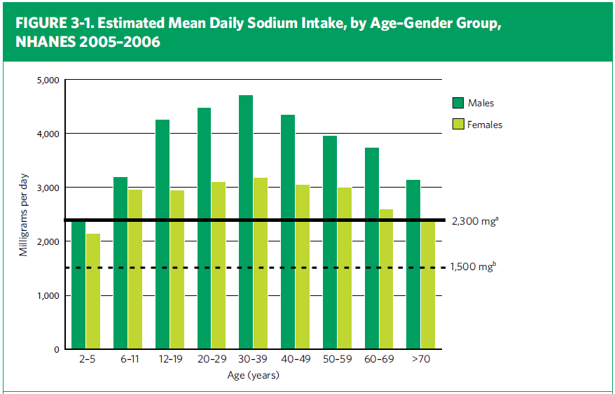
U.S. Sodium Intake

Slide 32
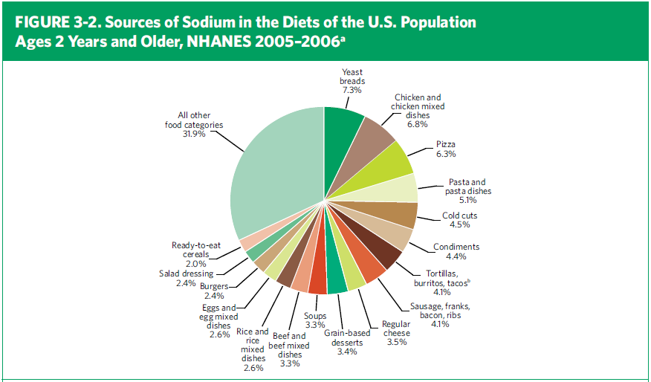
Food Sources of Sodium

Slide 33
Sodium Issues
IFIC, August, 2009
  Majority of those 55+ were trying to limit sodium
  Concerns linked to hypertension & heart disease
  Consumers were not sure how to identify foods higher in sodium
http://www.foodinsight.org/about-ific-and-food-safety.aspx

Slide 34
Sodium Issues
Institute of Medicine, 2010
www.iom.edu
  Hypertension costs $73.4 B in 2009, direct & indirect costs
  Recommendations:
    ↓ sodium
    77% sodium from food processing
    Collaborate with food industry to ↓ sodium
    ↑ fruits/vegetables
    ↑ physical activity
    ↑ attention by public health agencies

Slide 35
Sodium Sources
Order the following items from highest to lowest for the amount of sodium
  10 French fries, frozen, oven roasted
  ½ cup prepared chocolate pudding
  ½ cup sweetened applesauce
  1 slice whole wheat bread
  1 slice rye bread
  ½ cup 1% fat cottage cheese
  ½ cup tuna salad
  1 cup 1% milk

Slide 36
Sodium Sources
Goal: 500 mg/meal Per DGA Recommendations
Order the following items from highest to lowest for the amount of sodium
  ½ cup 1% fat cottage cheese 459 mg
  ½ cup tuna salad 412 mg
  1 slice rye bread 211 mg
  10 french fries, frozen, oven roasted 194 mg
  ½ cup prepared chocolate pudding 172 mg
  1 slice whole wheat bread 132 mg
  1 cup 1% milk 107 mg
  ½ cup sweetened applesauce 2.5 mg
USDA Handbook 23, http://www.nal.usda.gov/fnic/foodcomp/search/

Slide 37
Advice to Reduce Sodium Intake
Read the Nutrition Facts label
Consume more fresh foods and fewer processed foods high in sodium
Eat more foods prepared at home
When eating at restaurants, ask that salt not be added to your food
Notes:
The document includes specific advice for consumers on how to reduce sodium intake, including the suggestions listed on this slide
And, as noted on another slide, it also calls for a deliberate reduction in the sodium content of foods available in the marketplace.

Slide 38
Ch. 3: Foods and Food Components to Reduce
Key Recommendations
Consume less than 10 percent of calories from saturated fatty acids by replacing them with monounsaturated and polyunsaturated fatty acids.
Consume less than 300 mg per day of dietary cholesterol.
  Up to 1 egg yolk/day
  Small effect compared to saturated and trans fats

Slide 39
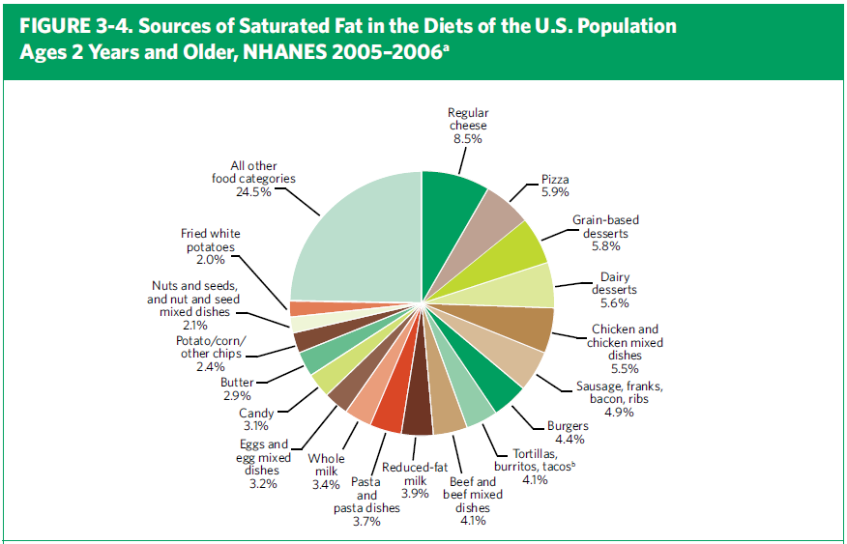
Food Sources of Saturated Fats

Slide 40
Ch. 3: Foods and Food Components to Reduce
Key Recommendations
Keep trans fatty acid consumption as low as possible by limiting foods that contain synthetic sources of trans fats, such as partially hydrogenated oils, and by limiting other solid fats.
Reduce the intake of calories from solid fats and added sugars (SoFAS).
Notes:
(continued)
40

Slide 41
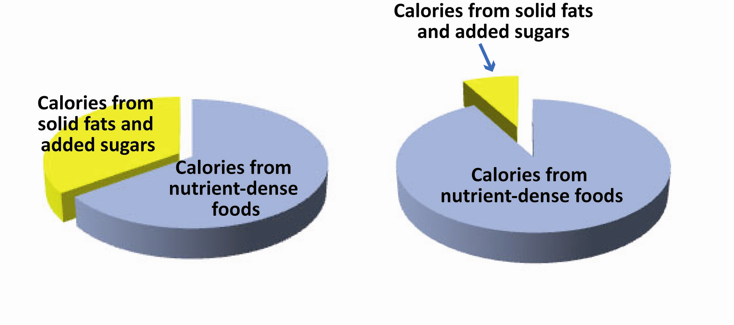
Ch. 3: Foods and Food Components to Reduce
What We Eat Recommended Limits
Notes:
Note: The depiction of the proportionate amounts of total calories consumed and the recommended limits are illustrative only. The figure illustrates about 35 percent of total calories consumed as SoFAS, on average, in contrast to a recommended limit of no more than about 5 to 15 percent of total calories for most individuals.

Slide 42
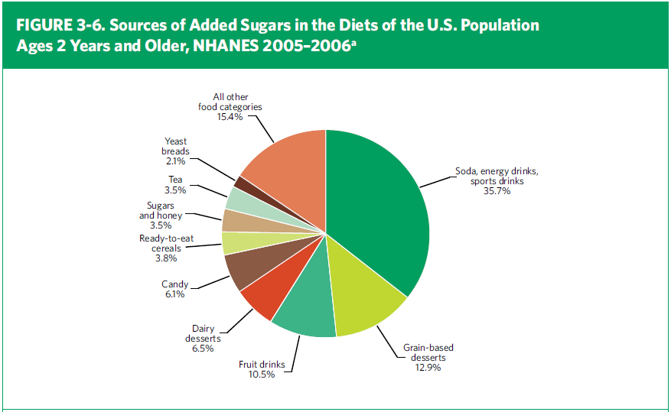
Food Sources of Added Sugars

Slide 43
Ch. 3: Foods and Food Components to Reduce
Key Recommendations
Limit the consumption of foods that contain refined grains, especially refined grain foods that contain solid fats, added sugars, and sodium.
If alcohol is consumed, it should be consumed in moderation--up to one drink per day for women and two drinks per day for men--and only by adults of legal drinking age.
Notes:
(continued)
43

Slide 44
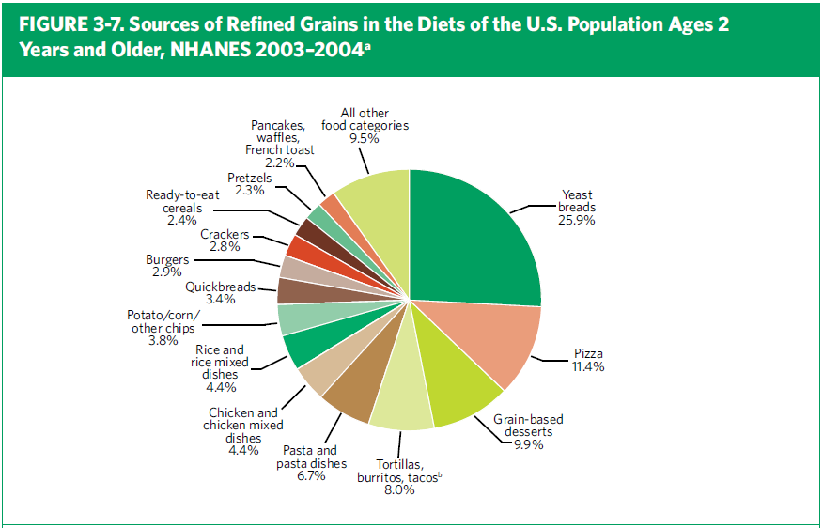
Food Sources of Refined Grains

Slide 45
Key Recommendations
Ch. 3: Foods and Food Components to Reduce
Refined grains
Limit consumption of refined grains, especially those that contain solid fats, added sugars, and sodium
Enriched refined grain products provide some vitamins and minerals, but not the fiber provided by whole grains
Replace refined grains with whole grains
Notes:
Another new key recommendation is to limit refined grains, especially those that contain solid fats, added sugars, and/or sodium.

Slide 46
Decrease
Reduce sodium intake to 1500 mg per day
Cholesterol less than 300 mg/day
Less than 10% of calories from saturated fat
Trans fat as low as possible
Solid Fats
Added Sugars
Refined Grains
Alcohol
Notes:
The Chapter 2 Key Recommendations are listed here

Slide 47
Ch. 4: Foods and Nutrients to Increase
Key Recommendations
Individuals should meet the following recommendations as part of a healthy eating pattern while staying within their calorie needs.
Increase vegetable and fruit intake.
Eat a variety of vegetables, especially dark-green and red and orange vegetables and beans and peas.
Notes:
Key recommendations from chapter 4: foods and nutrients to increase.
Note that an individual should follow these recommendations while still staying within his or her calorie needs. In other words, these foods should replace less healthy choices in the diet.
47

Slide 48
Ch. 4: Foods and Nutrients to Increase
Key Recommendations
Consume at least half of all grains as whole grains. Increase whole-grain intake by replacing refined grains with whole grains.
Increase intake of fat-free or low-fat milk and milk products, such as milk, yogurt, cheese, or fortified soy beverages.
Choose a variety of protein foods, which include seafood, lean meat and poultry, eggs, beans and peas, soy products, and unsalted nuts and seeds.
Notes:
Key recommendations from chapter 4: foods and nutrients to increase.
Note that an individual should follow these recommendations while still staying within his or her calorie needs. In other words, these foods should replace less healthy choices in the diet.
48

Slide 49
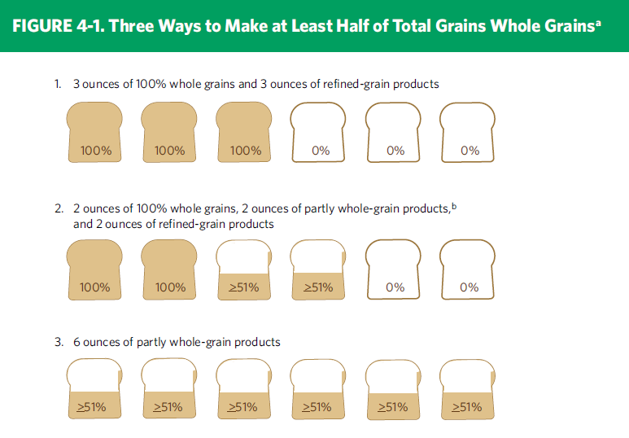
Whole Grain Guidance
Notes:
This slide shows an example of a explanatory graphic from the Guidelines. The actual Guideline for whole grains is “consume at least half of your grains as whole grains,” and this figure shows 3 different ways of how someone could choose to make half of their total grain intake whole grain, using bread as an example.

Slide 50
Ch. 4: Foods and Nutrients to Increase
Key Recommendations
Increase the amount and variety of seafood consumed by choosing seafood in place of some meat and poultry.
Replace protein foods that are higher in solid fats with choices that are lower in solid fats and calories and/ or are sources of oils.
Notes:
(continued)
50

Slide 51
Ch. 4: Foods and Nutrients to Increase
Key Recommendations
Use oils to replace solid fats where possible.
Choose foods that provide more potassium, dietary fiber, calcium, and vitamin D, which are nutrients of concern in American diets. These foods include vegetables, fruits, whole grains, and milk and milk products.
Notes:
(continued)
51

Slide 52
Ch. 4: Foods and Nutrients to Increase
Key Recommendations for Older Adults
Individuals ages 50 years and older:
Consume foods fortified with vitamin B12, such as fortified cereals, or dietary supplements.
Be food safe, older adults, and individuals with weakened immune systems (such as those living with HIV infection, cancer treatment, organ transplant, or liver disease) are more susceptible to foodborne illness
Reduce intake to 1,500 mg sodium among persons who are 51 and older and those of any age who are African American, or have hypertension, diabetes, or chronic kidney disease.
Notes:
(continued…but for special population groups)
52

Slide 53
Increase
Vegetables & fruits
Variety of vegetables
Whole grain products
Fat free, low-fat dairy
Variety of protein foods
Notes:
Chapter 4 Key Recommendations for everyone age 2 and older

Slide 54
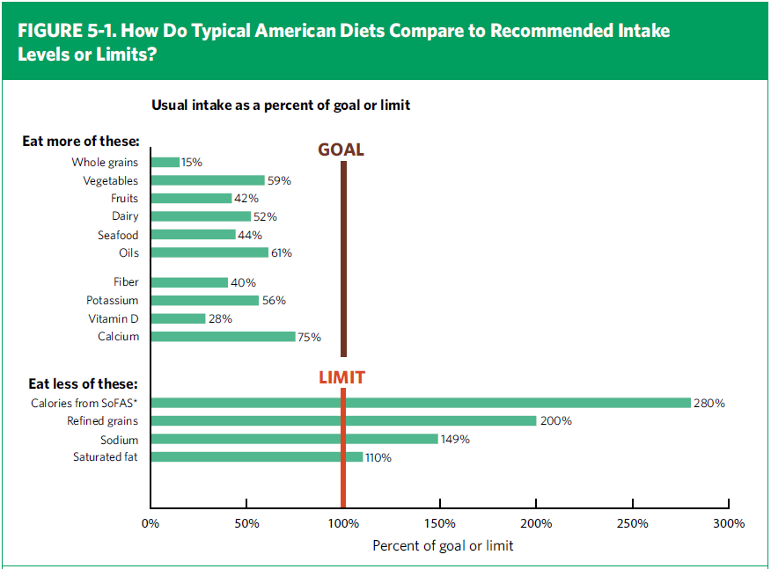
Comparison of Consumption to Recommendations
Notes:
This chart shows how the average American diet compares to recommendations found in the 2010 Dietary Guidelines. Whole grains, vegetables, fruits, dairy products, seafood, and oils are consumed below recommended amounts. Nutrients of concern are fiber, potassium, calcium, and vitamin D. Note that the intake shown for vitamin D only includes food sources, not supplements or vitamin D manufactured in response to sun exposure.
The excessive amounts consumed of solid fats and added sugars, refined grains, and sodium are clearly shown in comparison to recommended limits.

Slide 55
Ch. 5: Building Healthy Eating Patterns
Key Recommendations
Select an eating pattern that meets nutrient needs over time at an appropriate calorie level.
  USDA Food Patterns
  DASH Eating Plan
Account for all foods and beverages consumed and assess how they fit within a total healthy eating pattern.
Follow food safety recommendations when preparing and eating foods to reduce the risk of foodborne illnesses.
Notes:
Key recommendations from chapter 5: building healthy eating patterns
Don’t forget about food safety, which is an important component of a healthy diet.
55

Slide 56
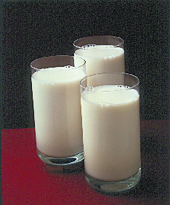
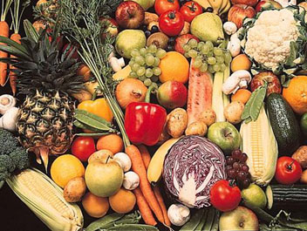
Recommended Eating Pattern
Dietary Approaches to Stop Hypertension - DASH
Based on random controlled, clinical trials by the National Heart, Lung, Blood Institute of the National Institute of Health, also researched internationally
Various studies: original DASH, DASH-Sodium, DASH-Low fat
Emphasis: vegetables, fruits, low-fat milk & dairy products, whole grains, poultry, seafood, nuts
Reduced hypertension, reduced cardiovascular disease, lowered mortality

Slide 57
DASH Eating Plan
Food Group | 550 Calories | 700 Calories
Grains | 2 servings | 2.5 servings
Vegetables | 1.5 servings | 2 servings
Fruits | 1.5 servings | 2 servings
Low-fat dairy | 1 serving | 1.5 serving
Lean meat, poultry, fish | 1.33 serving or less | 1.75 serving or less
Seeds, nuts, legumes | 1/week | 1/week
Fats & oils | .5 serving | .5 serving
Sweets | Less than 1/week | Less than 1/week

Slide 58
Recommended Eating Patterns
USDA Food Patterns
Daily amounts of foods to eat from 5 major food groups
Meet DRIs and DGAs, not clinically tested
Similar to the DASH
Emphasis on selecting a variety of foods from each food group (vegetables, fruits, grains, dairy products, protein foods)
Vegetarian adaptations

Slide 59
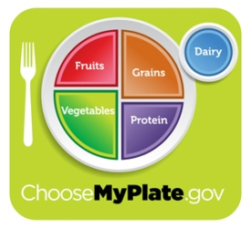
USDA Food Pattern
Food Group | 550 Calories | 700 Calories
Fruits | ½ cup (1 serving) | 2/3 cup (1.3 serving)
Vegetables | ½ cup (1 serving) | 2/3 cup (1.3 serving)
Grains | 1.5 oz equiv. | 2 oz equivalent
Protein foods | 1.1 oz equivalent | 1.4 oz equivalent
Dairy | 1 cup | 1.4 cups
Oils | 8.25 grams | 10.5 grams
Maximum SoFAS Empty Calories | 75 calories | 95.9 calories

Slide 60
Embedding Evidence Based Practice in Nutrition Services
Menu planning
Nutrition education
Nutrition counseling

Slide 61


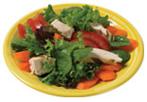
Principles of Menu Planning
Aesthetic appeal:
  Enhance taste
  Strive for balance
  Emphasize variety
  Add contrast: texture & temperature
  Think about color
  Consider eye appeal

Slide 62
Menu Planning
Challenges
Reducing sodium, fat, added sugars, refined grains
Increasing fruits, vegetables, whole grains
Increasing fiber, potassium, calcium vitamin D
Increasing lean protein sources

Slide 63
Menu Planning
Challenges
Cultural/ethnic/religious menus
Consumer choice and satisfaction
Budget constraints
Catering or vending contracts

Slide 64
Menu Planning
Challenges
Maintain quality
Allocating labor
Meet requirements for therapeutic meal
Maintain food safety and temperatures

Slide 65
Menu Planning Solutions
Improve menu planning
Efficient use of labor
Improve purchasing practices

Slide 66
Ideas
Reduce Sodium
  Use low sodium products
  Decrease prepared sauces
  Decrease cheese, high sodium meats
  Work with vendors/caterers
  Decrease convenience foods
  Increase “from scratch” cooking
Increase fruits and vegetables
Increase lower saturated fat foods

Slide 67
Ideas
Increase use of nuts/seeds/legumes
Use dessert “trade-off’s
  Nutrient dense desserts
  Limit serving size
  Limit baked or commercial desserts to one per week.

Slide 68

Customer Input
Menu committees
Product sampling
Taste panels
Food preference surveys
Satisfaction focus groups
Comment cards

Slide 69
Food Safety
Retain temperature
Retain quality, despite holding times
Select safe foods
Select foods, dishes that ease safe food handling
Comply with food code

Slide 70

What’s on Your Plate?

Slide 71
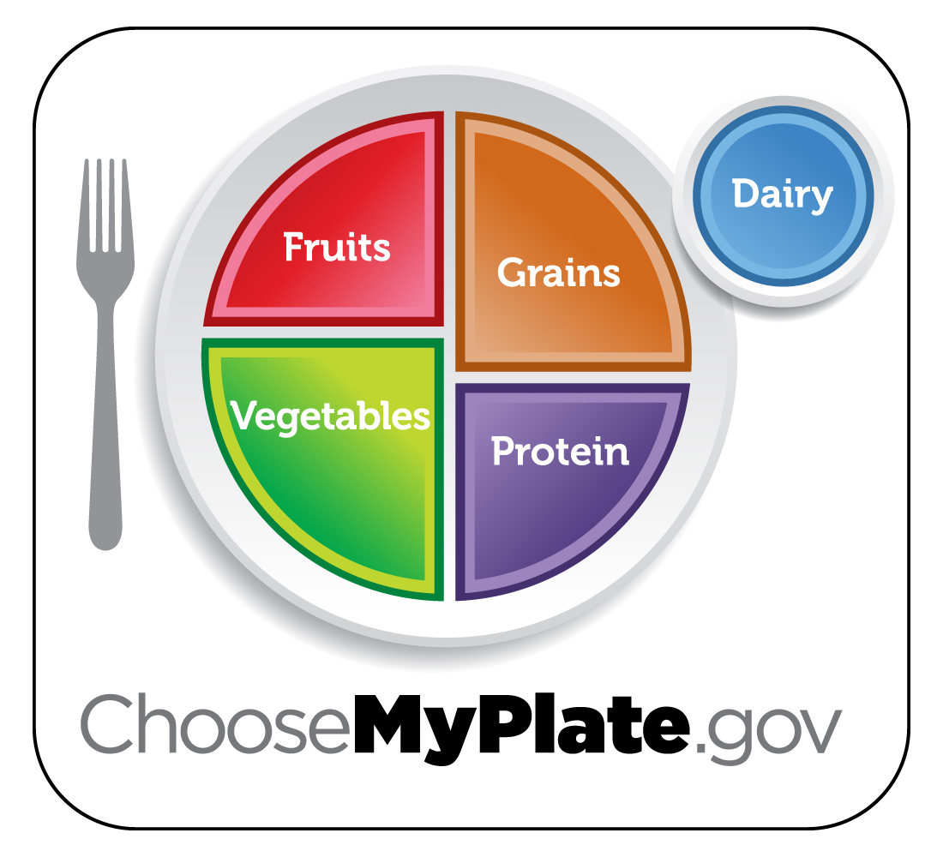

Slide 72
Turkey Menu
Special Emphasis: Fiber, potassium, sodium
Roast turkey (2 oz)
Baked sweet potato (1 small)
Broccoli (1/2 cup)
Whole wheat roll (1 2.5” roll)
Apple raisin crisp (1/2 cup, includes topping of whole wheat flour and fortified flake cereal; almonds and raisins)
Fat-free milk (1 cup)

Slide 73
Turkey Menu
 | Standard | Meal Content
Calories | 550-700 kcal | 724 kcal
% Fat | 30-35% | 25 %
Fiber | 7 – 8 g | 13 g
Calcium | 400 mg | 630 mg
Potassium | 1566 mg | 1763 mg
Sodium | 500 mg | 423 mg

Slide 74

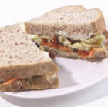
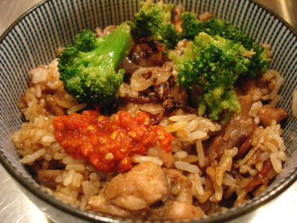
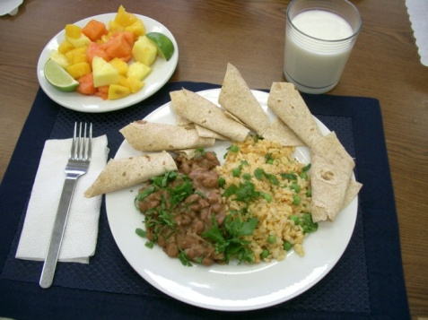
How can we make healthy choices?
Calories
Physical activity
Vegetables
Fruits
Dairy & dairy alternates
Protein foods
Grains

Slide 75
Communicating the Dietary Guidelines: Starter Consumer Messages
• Enjoy your food, but eat less.
• Avoid oversized portions.
• Make half your plate fruits and vegetables.
• Switch to fat-free or low-fat (1%) milk
• Compare sodium in foods like soup, bread, and frozen meals—and choose the foods with lower numbers.
Read food labels
• Drink water instead of sugary drinks.
Notes:
These six messages were released as “selected messages” to initially accompany the Guidelines. The wording of these messages has been consumer-tested.
75

Slide 76
Behavior Changes
Overall weight management
  Calorie intake
  Physical activity
Foods
  Vegetables
  Fruits
  Dairy products/dairy alternates
  Protein foods

Slide 77
Behavior Changes
Foods
  Grains
    Whole grains
    Refined grains
Food Components
  Oils & Fats
    Oils
    Solid fats

Slide 78
Behavior Changes
Foods Components
  Added Sugars
  Sodium
  Alcohol
Keep Foods Safe
  Clean (hands, surfaces, food)
  Separate foods (when shopping, preparing & serving)
  Cook & chill (safe temperatures)

Slide 79

Dietary Guidelines Resources
www.health.gov/dietaryguidelines
www.healthfinder.gov
www.dietaryguidelines.gov
www.nutritionevidencelibrary.gov
www.choosemyplate.gov/
www.myfoodapedia.gov/
Notes:
79
For more information, please check out the websites above.
Of note, healthfinder.gov has been designed especially for consumers, based on the principles of health literacy (ensuring that information is accessible and actionable).

Slide 80

Other Resources
Administration on Aging http://www.aoa.gov/
Fight BAC! http://www.fightbac.org/
Be Food Safe http://www.fsis.usda.gov/Be_FoodSafe/
Is It Done Yet? http://www.fsis.usda.gov/is_it_done_yet/
Thermy http://www.fsis.usda.gov/food_safety_education/thermy/index.asp
1
Notes:
80
For more information, please check out the websites above.
Of note, healthfinder.gov has been designed especially for consumers, based on the principles of health literacy (ensuring that information is accessible and actionable).

Slide 81
Other Federal Resources
Reliable, Science Based Information
www.health.gov/paguidelines
www.nutrition.gov
www.dietaryguidelines.gov
www.cnpp.usda.gov
http://fnic.nal.usda.gov
http://odphp.osophs/dhhs.gov
www.fda.gov
www.cdc.gov
www.nih.gov
www.physicalactivityplan.org
Notes:
81
For more information, please check out the websites above.
Of note, healthfinder.gov has been designed especially for consumers, based on the principles of health literacy (ensuring that information is accessible and actionable).

Slide 82
Acknowledgement
Linda Netterville, MS, RD
VP MOWAA
DGA 2010 slide materials provided by the Office of Disease Prevention & Health Promotion, HHS

Slide 83
Thank You
Jean L. Lloyd
National Nutritionist
U S Administration on Aging
Jean.Lloyd@aoa.hhs.gov

